Slide 1
MVAR Analysis of iEEG Signals to Differentiate Conscious States
INF/01
Ph.D. Candidate:
TERESA RUTIGLIANO
Supervisor: Prof. RITA PIZZI
School Director:
Prof. PAOLO BOLDI

Slide 2
Brain Research
Brain Research is an interdisciplinary area with many different challenges, such as:
Understanding the neurophysiological connections between brain areas (Connectome) and their functional meaning
Revealing mechanisms that may define and recognize complex cognitive tasks
Novel computational tools are required!
February 27, 2018
Notes:
Brain research Is interdisciplinary, its challenges are many and different expertises are required.
One of the challenge is to investigate the so called Connectome (=the wiring diagram of the brain) and to describe cognitive mechanisms.
Novel tools and approaches are needed in order to integrate and advance in neuroscience knowledge

Slide 3
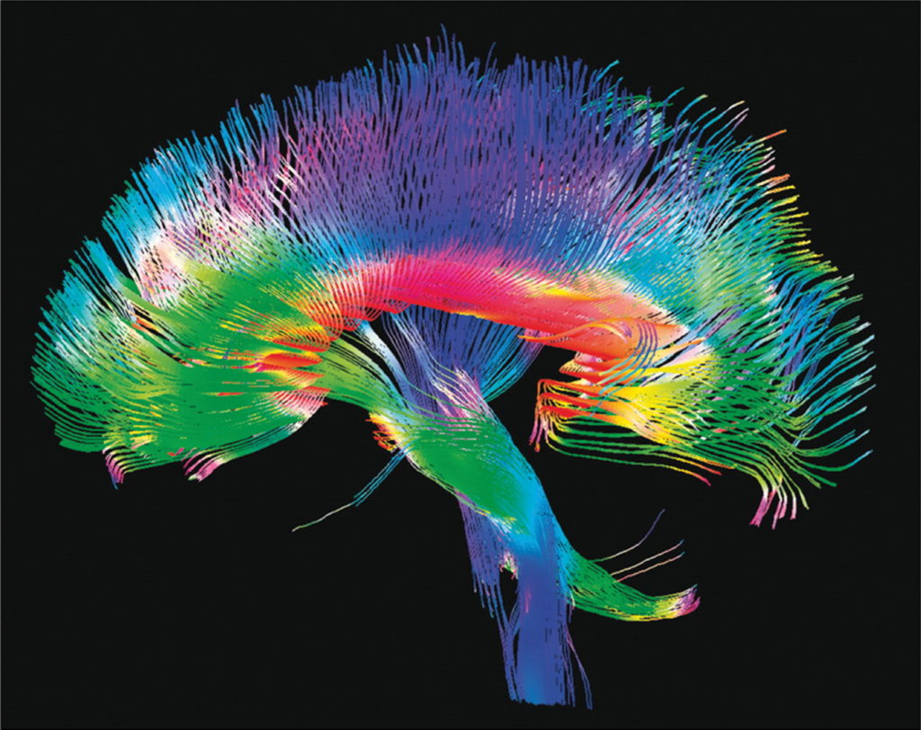
Connectome and Connectivity
Human Connectome Project
Every connectome (brain wiring) displays unique structural and functional features that might explain differences in cognition and behavior
February 27, 2018
Notes:
What is connectome? How is it related to consciousness?
The connectome is the complete description of the structural and functional connectivity of the nervous system. Connectome is the description of how neurons interact and how brain areas communicate.

Slide 4
Connectivity and Consciousness
Main aim of the dissertation is to understand the neural signatures of consciousness investigating the connectome ( functional connectivity)
Some connectivity models from literature:
Antony et al., 2013 -> iEEG/epileptogenicity
Schrouff et al., 2011 -> fMRI/consciousness
Matsumoto et al., 2004 -> EcoG/human language
Brovelli et al., 2004 -> monkey iEEG, fMRI/ behavioral studies
February 27, 2018
Notes:
Leggo prima fase e concludo con..
In particular the functional connectivity
Where Functional connections coincide with the activity of correlations in time; these kind of connections can be observed also between pairs of anatomically unconnected regions.
Functional connectivity studies had provided evidences for the organization of brain networks, in the slide some works are repoted from literature: intracranial electroencephalography an imaging studies have been perfomed to analyze pathologies and behaviours.

Slide 5
Connectivity and Consciousness
To the best of our knowledge, no study has yet investigated functional connectivity using human iEEG data that are the gold standard to analyze differences between signals in brain cortex (with millisecond time resolution and centimeter spatial resolution)
February 27, 2018
Notes:
Leggo

Slide 6
Connectivity and Consciousness
Massimini et al., 2012:
By means of
transcranial magnetic stimulation (TMS) + intracranial single-pulse electrical stimulation and EEG recordings (intracranial EEG-iEEG)
Observed:
wakefulness and REM (Rapid Eye Movement sleep) = long-range patterns of activation
NREM Sleep (Non-Rapid Eye Movement sleep) and Midazolam-induced anesthesia = the feature is lost
February 27, 2018
Notes:
Our project is based on the evidence of Massimini’s group, they carried out studies by means of two techniques: the combination of transcranial magnetic stimulation (TMS) and intracranial single-pulse electrical stimulation (SPES) with simultaneous stereotactic EEG (SEEG) recordings, where electrodes are placed deep into the cortex (intracranial EEG-iEEG) [21]. They observed that during wakefulness (WAKE) and REM (Rapid Eye Movement sleep) (that are considered both as conscious states) the brain sustains long-range patterns of activation, whereas during NREM (Non-Rapid Eye Movement sleep) and Midazolam-induced anesthesia (when consciousness fades) this feature is lost

Slide 7
A possible marker of consciousness
Pigorini et al., 2015:
The electrical perturbation
in conscious state is followed by a time variant signal behavior: activation, silencing, reactivation.
in unconscious state the silencing stage is not followed by reactivation (=down state)
NREM Sleep -> NREM
wakefulness -> WAKE
February 27, 2018
Notes:
Trying to explain better this long range pattern activation we have to introduce another work by pigorini et al.
It is possible to detect differences between conscious and unconscious states also comparing signal waves in a neural network.
Pigorini et al [21] compared evoked potentials recorded during wakefulness and NREM sleep by means of time–frequency analysis. During WAKEfulness, the electrical stimulation provides effects that last for at least 500 ms, while during NREM the same initial activation is present but followed by neural silence. In other words., The perturbation in WAKE is followed by a composite set of waves, notably a down-state then an increases in activation; in NREM the reactivation effect is not present.
Massimini et al. [20] hypothesized that the silente period is not due to the interruption of connections, but rather to changes in the neuronal dynamics. So, a possible explanation of the re-activation, observable in WAKE and not in NREM sleep, could be a trace from the rest of the network that we can call “feedback wave”.
In the next slides the NREM awill be called only SLEEP and Wakefulness WAKE

Slide 8
Aims of the Thesis
Evaluate brain network changes during different levels of consciousness
Classify WAKE/NREM states
Assess parameters that correlate with the level of consciousness
Investigate the role of the reactivation phenomenon
Analyze the functional meaning of the adoption of re-reference styles
February 27, 2018
Notes:
leggo

Slide 9
Dataset
iEEG: intracranial EEG signals
wakefulness
(WAKE)
NREM Sleep, stage 3
(NREM)
Five subjects
8 channels/subjetc
29 stimulation session
Epochs 800 ms long (for each session)
REF: Deepak Lachhwani, MD, and Jorgé Gonzalez-Martinez, MD, PhD
February 27, 2018
Notes:
We analyzed neural activity acquired directly from the brain of human subjects suffering from epilepsy. Signals were acquired by contacts placed deep in to the cortex, the system was excited by an electrical stimulation.
Dataset was composed by: 5 patients, 8 contacts every patients. we analyzed 29 windowed time series (also called epochs) of 800 ms each, where every epoch started after the stimulation. Dataset is composed by 2 groups: one with patient awaken (from now on called Wake), the other during deep sleep stage (from now on called NREM)
Miei appunti
Neural activity= coming from potential difference (depolarization and repolarization) of neuron membranes)

Slide 10
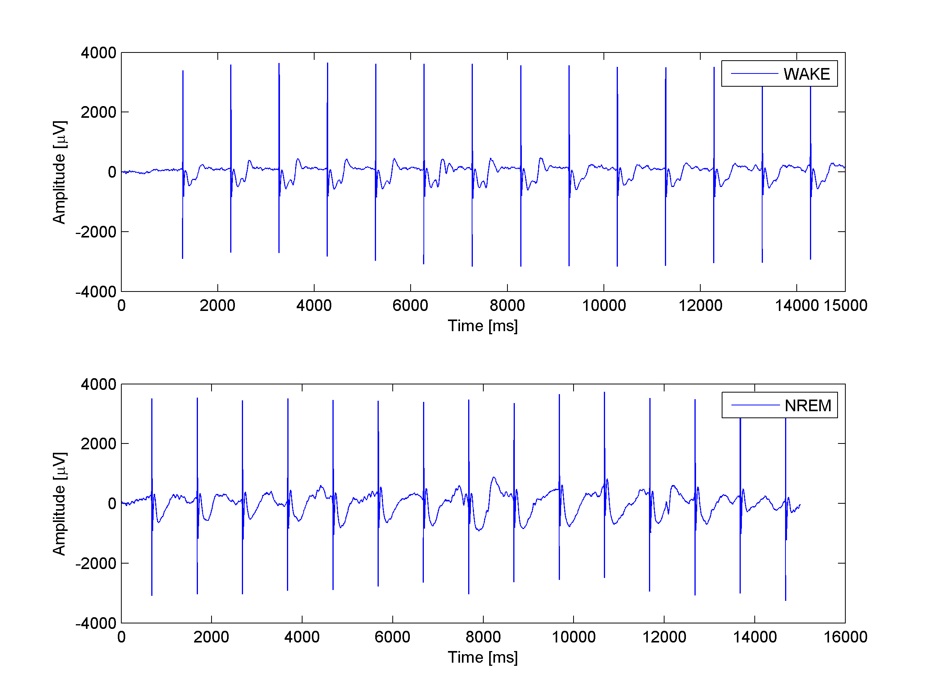
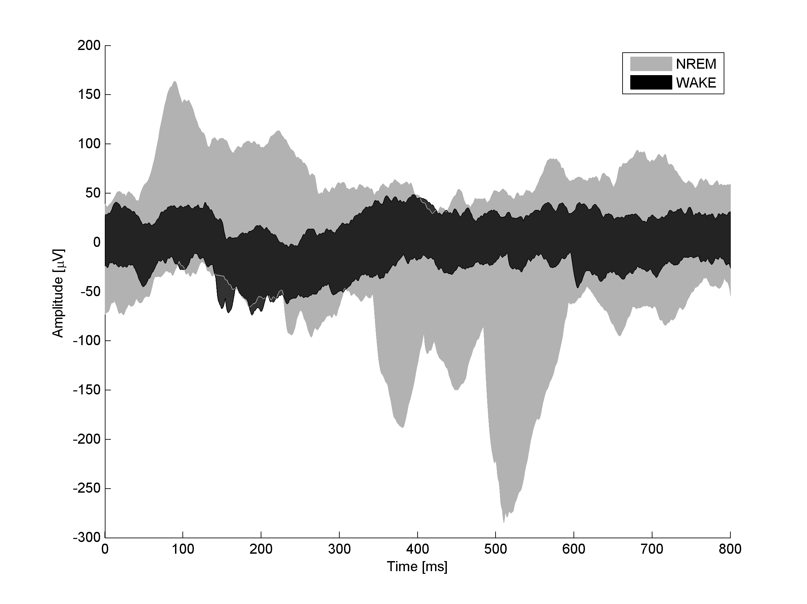
Dataset
iEEG: intracranial EEG signals
16 representative seconds of a raw
iEEG signal
Minimum and maximum values
of the signal in every epoch over time
February 27, 2018
Notes:
This slide is just to better understand the type of signal that composed the datatset.
Figure on the left shows 16 representative seconds of a raw iEEG signal in both WAKE and sleep condition. Here 15 stimulation sessions, with the corresponding impulses, are reported. Epoch, in our definition, is the signal recorded in the 800 ms after each stimulation.
Figure on the right shows Minimum and maximum values of the signal in each epoch over time for one channel in both conditions.
This technique is the gold standard method to obtain precise spatial and temporal indications of signals ..but it has some limitations ..(gira slide)

Slide 11
Methods
Type of Analysis | Methods | Main Aims
Connectivity Considering two frequency bands: Delta and Gamma | Directed Transfer Function (DTF) | Analyze the functional meaning of the adoption of re-reference styles Evaluate brain network changes linked to the consciousness
 | Adaptive DTF (Time Varying ) (ADTF) + Statistical Analysis (ANOVA/MANOVA) | Investigate the role of the reactivation phenomenon (down-state) Evaluate brain network changes linked to the levels of consciousness
Feature Extraction (FE) | Standard Deviation vs Wavelet coefficients + ANN classification. | Classify WAKE/NREM Sleep states
February 27, 2018
Notes:
We worked on two macroareas; the main one is the directional connectivity analysis; the Feature Extraction analysis was a parallel project.
In the next slieds We will focus our attention on the connectivity analysis, the second method will be quickly discussed at the end of the presentation.
This slide will be better detailed

Slide 12
Methods
Type of Analysis | Methods | Main Aims
Connectivity Considering two frequency bands: Delta and Gamma | Directed Transfer Function (DTF) | Analyze the functional meaning of the adoption of re-reference styles Evaluate brain network changes linked to the consciousness
 | Adaptive DTF (Time Varying ) (ADTF) + Statistical Analysis (ANOVA/MANOVA) | Investigate the role of the reactivation phenomenon (down-state) Evaluate brain network changes linked to the levels of consciousness
Feature Extraction (FE) | Standard Deviation vs Wavelet coefficients + ANN classification. | Classify WAKE/NREM Sleep states
February 27, 2018
Notes:
First method:
We Proposed the directional connectivity method as a model to compare conscious states and as a way to capture information on network dynamics. Directed Transfer Function and Adaptive directed Transfer Function, are used to reveal directional interactions between signals
We evaluate brain network changes according time and frequency variables.
We did this work focusing our attention on two frequency ranges : Gamma and Delta
Gamma (30-100Hz) because these oscillations have functional role in human episodic memory and cognitive tasks.
Delta (0,5-4Hz) oscillations are interesting to study NREM sleep, stage 3, that is also called slow wave sleep given that Delta waves prevail
In particular by means of DTF we analyzes.. (leggo main aims)
With ADTF, in particular, we Explored the phenomena known from literature as down-state and re-activation

Slide 13
Multivariate AutoRegressive model
Multivariate AutoRegressive model (MVAR):
Pattern from a unique model estimated on the whole set of signals
Reciprocal interactions are taken into account
Allows to recognize the direction of signals propagation
Allows to derive time/frequency domain images by using model coefficients and their spectral properties
February 27, 2018
Notes:
The connectivity model chosen is MVAR That permits the study of signal’s interdependence: in fact, the form of multichannel autoregressive models, is capable to identify the causal relationships between signals allowing to recognize the direction of propagation.
Autoregressive models (AR) are useful to model time series; they estimate the variable of interest using their past values.
An MVAR model allows to derive time/frequency domain images by using model coefficients and their spectral properties.

Slide 14
Multivariate AutoRegressive model
$$y\left(t\right)=−\sum_{k=1}^{p}{A\left(k\right)y\left(t−k\right)+u\left(t\right)}$$
Where
$$y\left(t\right)=\left[y_{1}\left(t\right), y_{2}\left(t\right), …,y_{N}\left(t\right)\right] ^{T}$$
data vector in time
A(1), A(2), … A(p) = NxN matrices of the model coefficients
$p$ = model order
$k$ = lag
$u\left(t\right)=$ independent white noise
February 27, 2018
Notes:
y (t) is a vector of stochastic processes (in our case, time series). therefore given the formula……, y (t) is the vector that contains the t-th sample of the N time series, p is the order of the model and represents the number of previous instants of each process, A (k) is an NxN matrix that contains the coefficients of the model, each referred to the k-th delay.
La definizione corretta del modello MVAR è:
y(t) è un vettore di processi stocastici (nel nostro caso serie temporali).
Dunque
data la formula, y(t) è il vettore che contiene il t-esimo campione delle N serie temporali,
p è l’ordine del modello e rappresenta il numero di istanti precedenti di ciascun processo,
A(k) è una matrice NxN che contiene i coefficienti del modello, ciascuno riferito al ritardo k-esimo.
INFO in più da non dire in discussione:
Da ref. PICCOLO:
i dati sono generati per mezzo di un modello MVAR e poi utilizzati come ingressi al modello stesso per l’analisi della connettività. (ECCO la definizione del LOOP!)
ARFIT: Esso consiste in una serie di moduli che, dati in ingresso i processi e l’ordine ottimo del modello, forniscono i valori dei parametri del modello basandosi su un algoritmo di stima ai minimi quadrati.
P rappresenta il numero di istanti di ciascun processo coinvolto nel modello, precedenti all’istante attuale che si sta descrivendo. il numero di coefficienti aij di un modello MVAR da stimare è m·m·p, dove m è il numero di processi coinvolti, si ha che il numero di parametri da stimare incrementa linearmente con l’aumentare dell’ordine del modello.
l’errore di predizione è una stima del rumore bianco dato in ingresso, se il modello fornisce una rappresentazione adeguata dei dati allora e(n) approssima una realizzazione di rumore bianco u(n).
(seguono frasi da non dire ma scritte qui solo come promemoria..
where 𝑦(𝑡)=[𝑦1 (𝑡),𝑦2 (𝑡),..,𝑦N (𝑡)]^{T} is the vector containing the N scalar processes at the time t and T is the transpose operator. p is the model order that represents the number of the previous outputs involved in the description of the current output. A(k) is the matrix NxN with coefficients from the AR model at the lag k, u(t) is a zero-mean white noise process with non-singular covariance.
Element 𝑎_𝑖𝑗 (𝑘) of the A(k) matrix describes the dependence of 𝑦_𝑖(t) on 𝑦_𝑗(t-k) .
Schwarz Bayesian Criterion
The MVAR model describes the value of each time series at the instant t as the weighted linear sum of the t-1,…t-p previous values ​​from all inputs with weights given by the coefficients 𝑎_𝑖𝑗. Coefficients on the diagonal reflect the weight that each signal has in its future self-description (auto-influence), while other elements describe cross-influences. The input covariance matrix is diagonal because the individual input processes are assumed to be uncorrelated with each other.
The advantages of MVAR modeling of multichannel EEG signals were stressed recently (Kus et al.,2004), by demonstrating the advantages of multivariate methods with respect to the pairwise autoregressive approach, both in terms of accuracy and of computational cost.

Slide 15
Connectivity Estimator: DTF
Directed Transfer Function (DTF) :
Frequency domain estimator of cross interactions based on the MVAR model
Uses spectral density
Defined by the elements of the transfer matrix H(f)= $\left|H_{ij}(f)\right|2$
H(f) is the inverse of the frequency-transformed coefficients matrix, A(f) (Fourier Transform)
February 27, 2018
Notes:
OK : The estimator used is
DTF is defined by the elements of the transfer matrix H(f) in the spectrum domain. H(f) is the inverse of A (f), which represents the Fourier Transform of model coefficients.
Tesi PICCOLO:
A(f) rappresenta la trasformata di Fourier dei coefficienti del modello.
H(f) e A(f) sono matrici m×m. L’elemento Hij(f) rappresenta la funzione di trasferimento tra l’i-esimo ingresso e la j-esima uscita del filtro generatore MVAR alla frequenza f con Hij(f) ?= Hji(f). Sì ,qui doveva invertire gli indici
Appunti per me: Transfer Function=Definizione generale=a mathematical function relating the output or response of a system such as a filter circuit to the input or stimulus.
How the output is related to the input

Slide 16
Connectivity Estimator: DTF
DTF is expressed by the normalized formula:
$D_{ij}\left(f\right)= \frac{\left|H_{ij}(f)\right|2}{\sum_{j=1}^{N}{\left|H_{ij}(f)\right|2}}$ $\sum_{j=1 }^{N}{D_{ij} (f)}$=1
Where
$H_{ij}(f)$ is the Transfer Matrix
N is the number of channels
It describes the directional flow from channel j (source) to i (sink) with values [0, 1]
 | j1 | j2 | j3
i1
i2
i3
February 27, 2018
Notes:
In particular DTF provides the percentage of power of signal i caused by j .
In order to compare the results obtained for cortical waveforms with different power spectra a normalization can be performed by dividing each estimated DTF by the squared sums of all elements of the row, thus obtaining the so-called normalized DTF (da tesi ASTOLFI)
miei appunti : Il denominatore è la sommatoria di tutti I flussi uscenti dai j tenendo fermo il canale ricevente i.

Slide 17
Connectivity Estimator: ADTF
The adaptive DTF (ADTF), a time-varying multivariate method, has been developed for the estimation of rapidly changing connectivity influences
It provides a 4D matrix
$D_{ij}\left(f,t\right)= \frac{\left|H_{ij}(f,t)\right|2}{\sum_{j=1}^{N}{\left|H_{ij}(f,t)\right|2}}$
February 27, 2018
Notes:
The second connectivity estimator used is:
The adaptive DTF (ADTF), a time-varying multivariate method, has been developed for the estimation of rapidly changing connectivity influences between cortical areas of the human brain [70][71]. The Adaptive DTF (ADTF) values are then defined as a function of both time and frequency. The formule is the same previously mentioned considering the 4dimension.
Miei appunti, da non dire:
The time-varying coefficient matrices of the AMVAR were tracked by using the Kalman filter algorithm [64] that provides instantaneous estimations of the spectral densities in terms of AR coefficient matrices

Slide 18
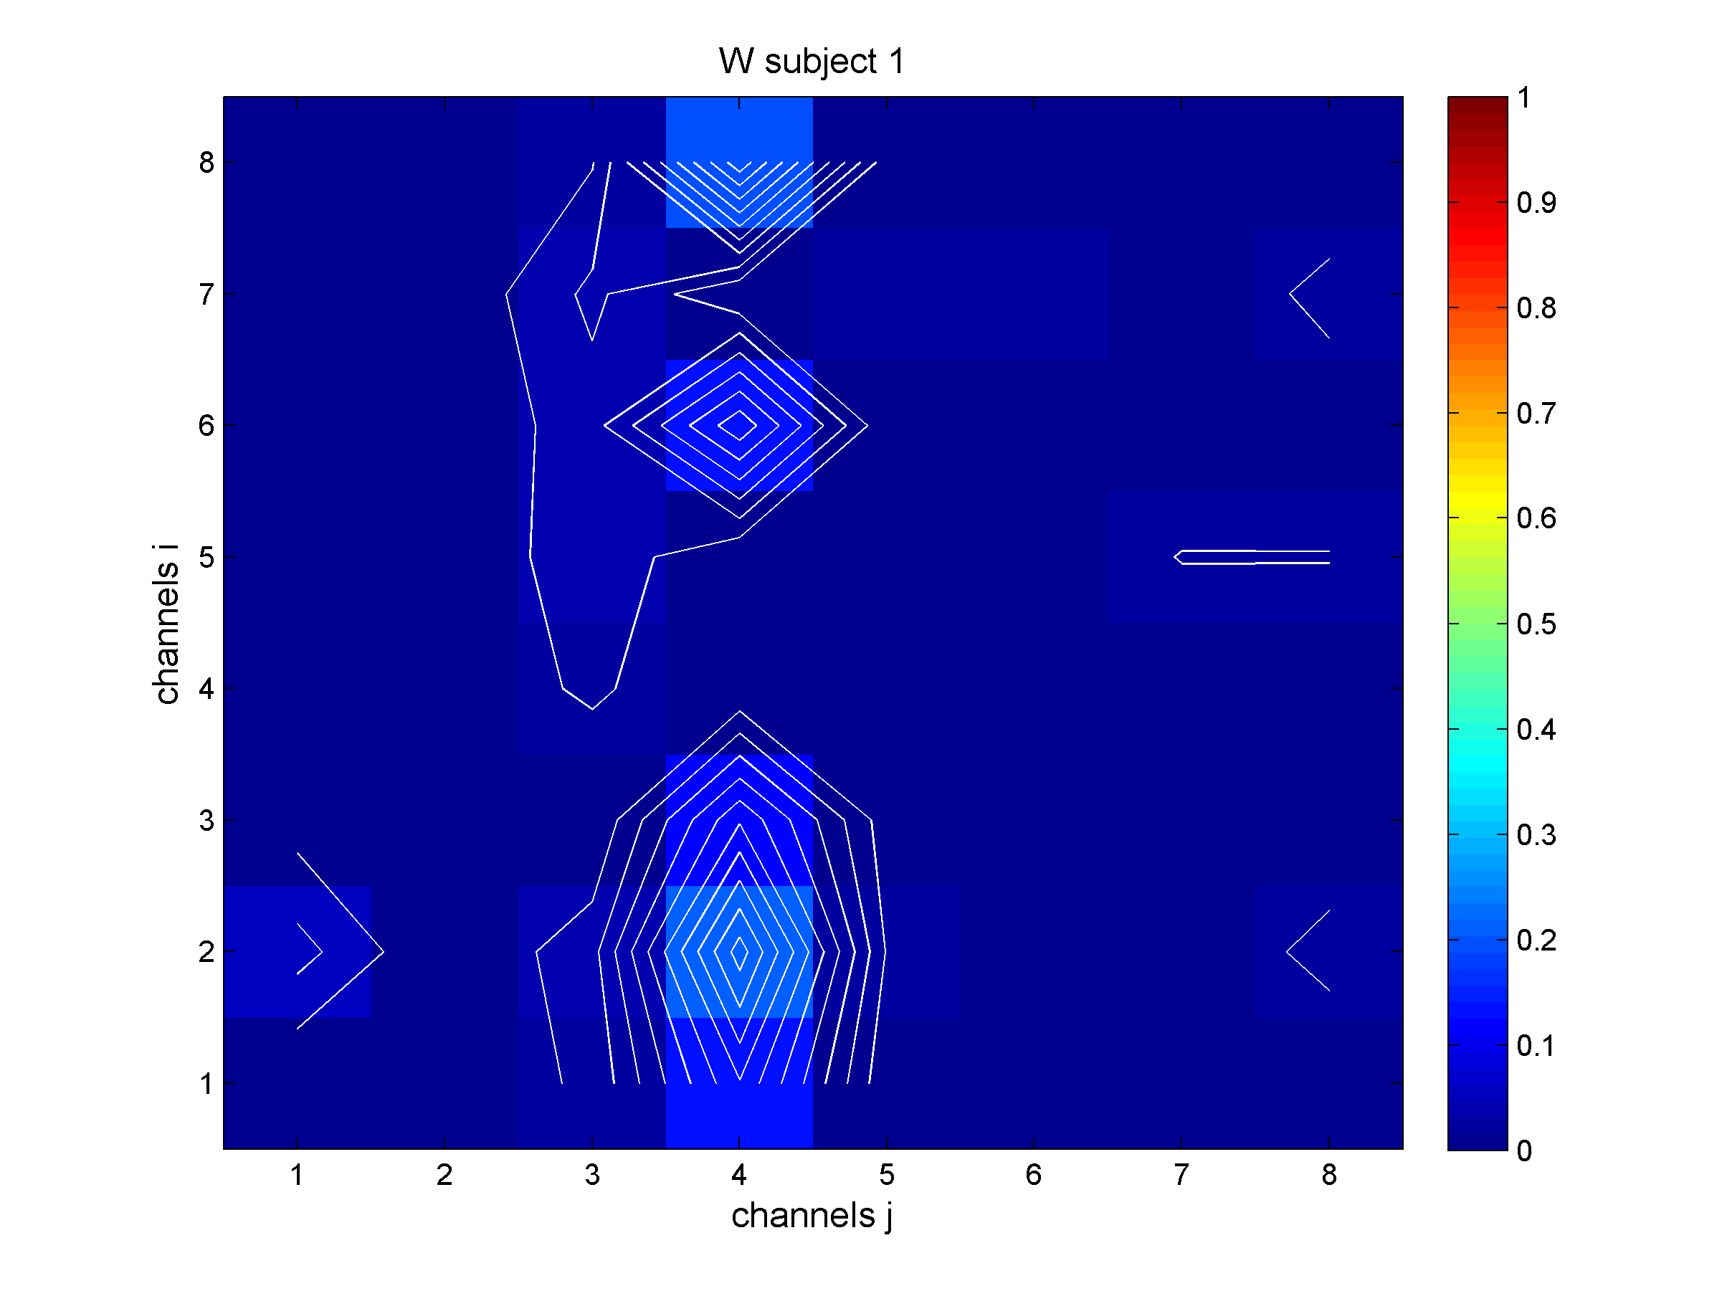
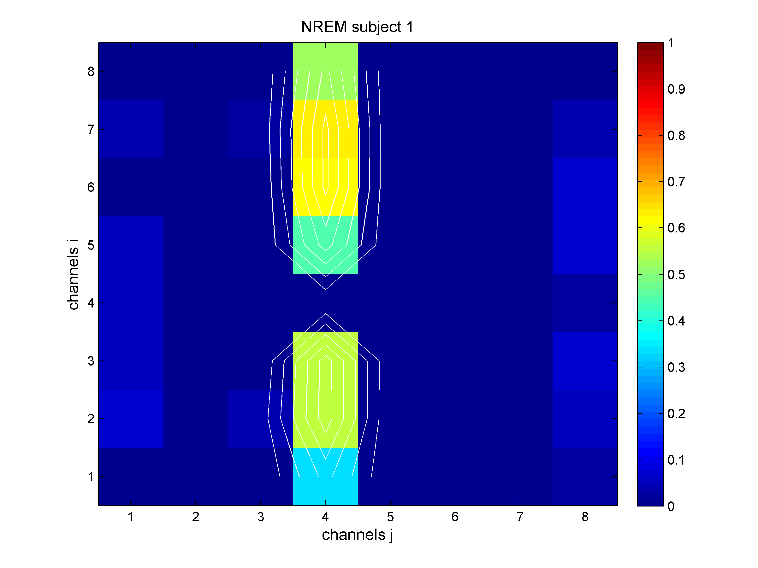
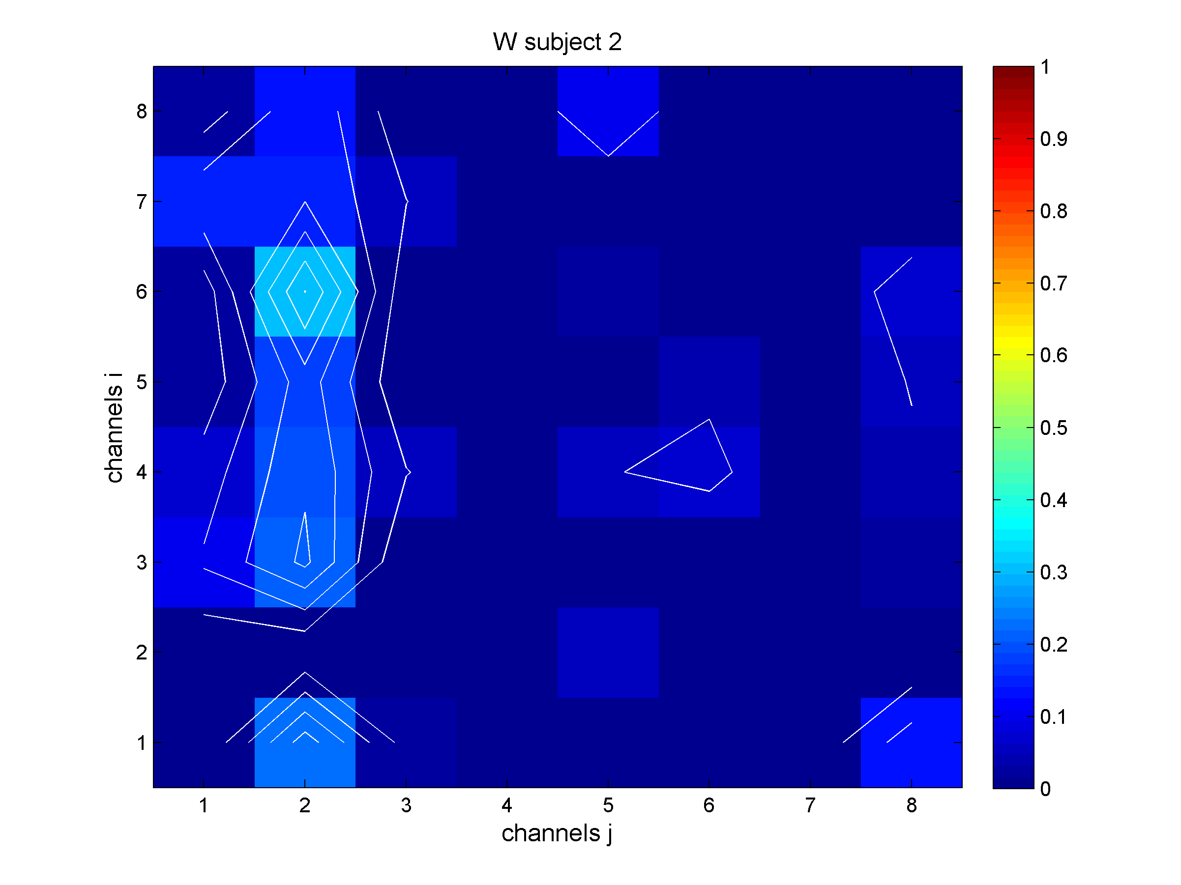
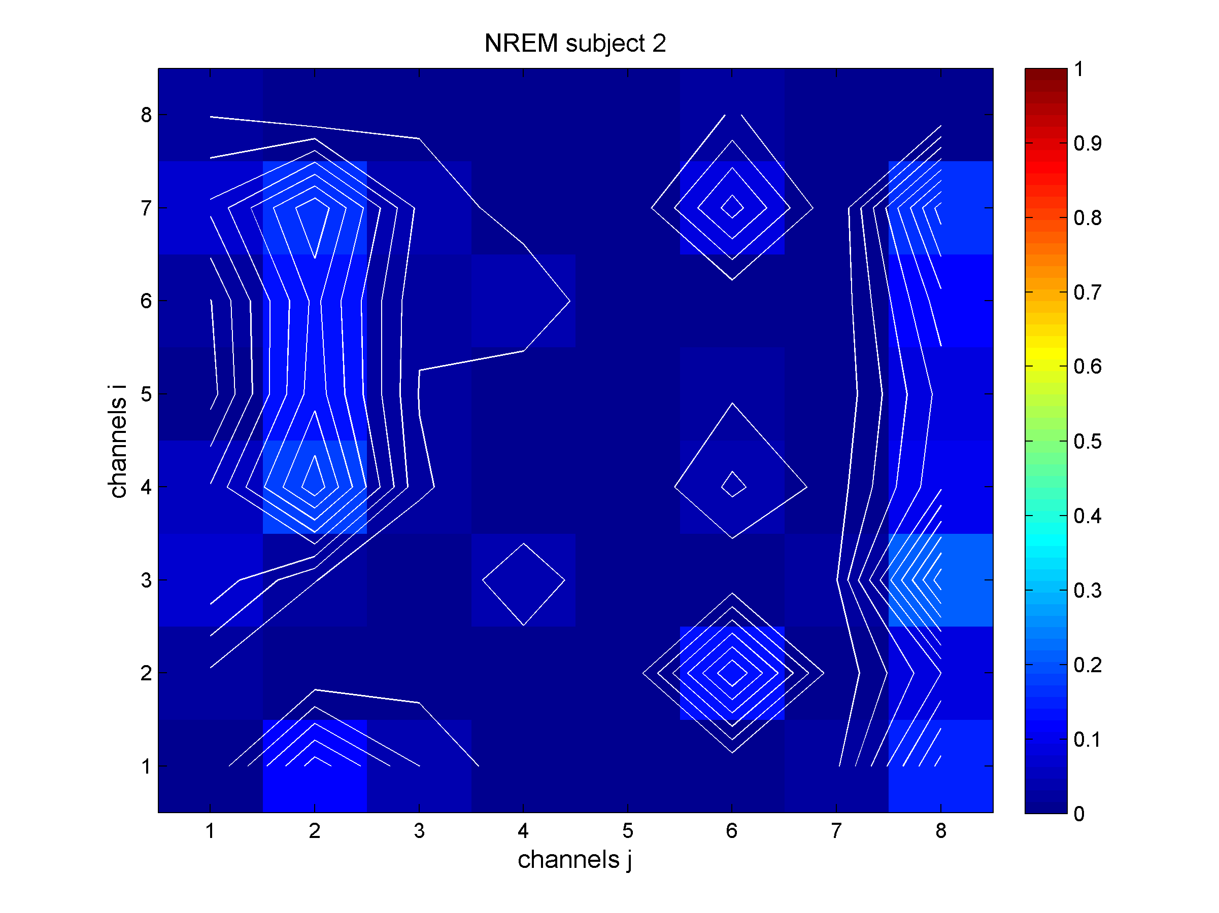
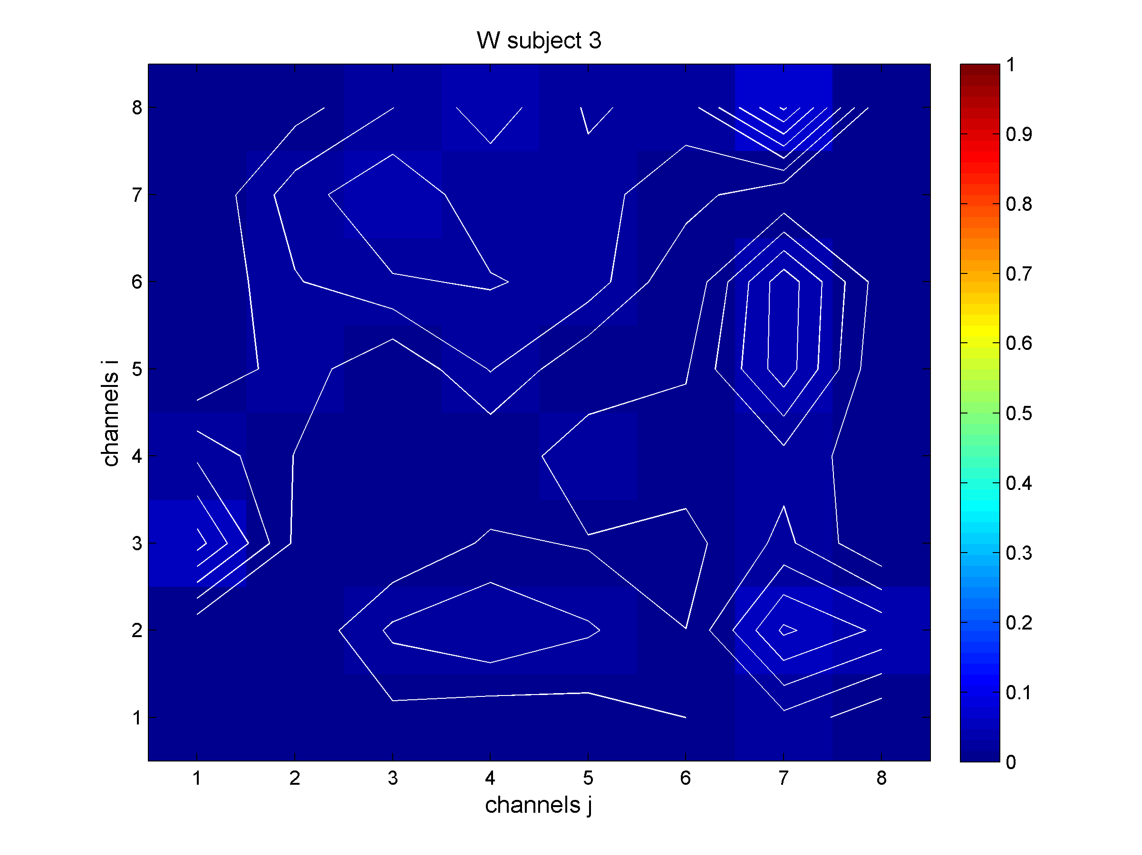
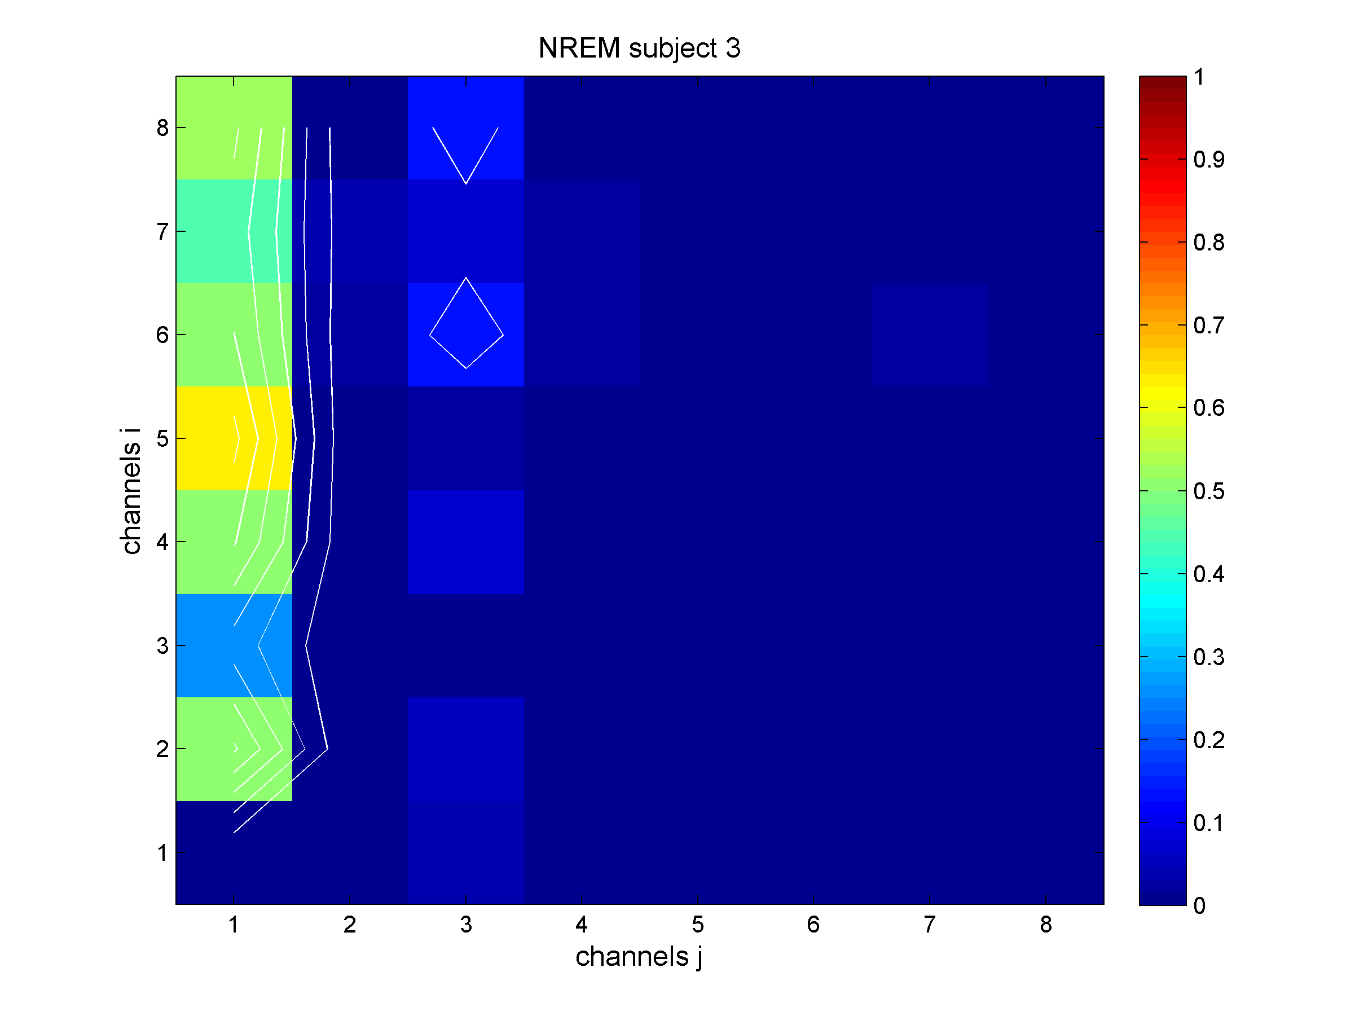
DTF Results
Averaged values in Gamma Frequency band (30-100 Hz)
WAKE | NREM
# 1
# 2
# 3
Information flow:
from j to i
DTF values:
NREM>WAKE
p < 0.05
February 27, 2018
Notes:
Talking about our results:
We teste Two conditions: WAKEfulness (WAKE) and SLEEP and two frequency ; here Gamma is involved in the analysis
Square matrices 8x8 (becasue we selected 8 channel/subject) were colours indicate the DTF levels, Wake status on the left and Sleep one on the right. Here just 3 representative subjects are reported. Information flow goes from j (columns) to i (rows). Only statistical significant (p < 0.05) connectivity measures coming from the procedure were considered (this has been done both for DTF and ADTF)
Notable is that in SLEEP condition source channels (column) are clearly distinguishable; this observation gives the idea that only some source channels are of foundamental importance and are able to influence (reach) many sinks positioned in many different brain areas.
Interestly, and opposite then expected, A quantitative assessment indicates that 4 over 5 subjects show higher DTF values in sleep than wake. This is interstly because Gamma oscillation are linked to the cognitive tasks and so to the wake status.

Slide 19
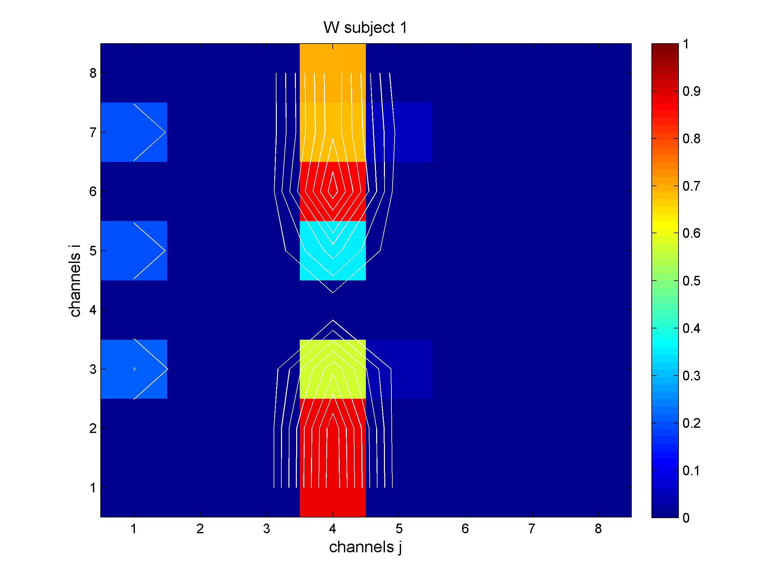
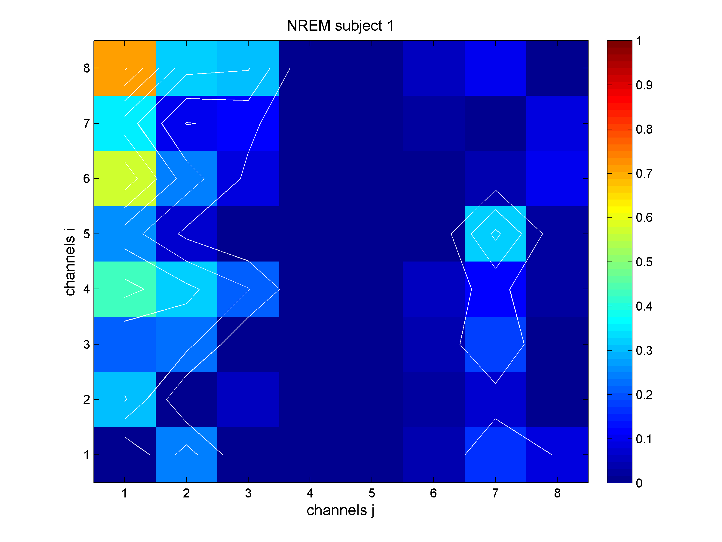
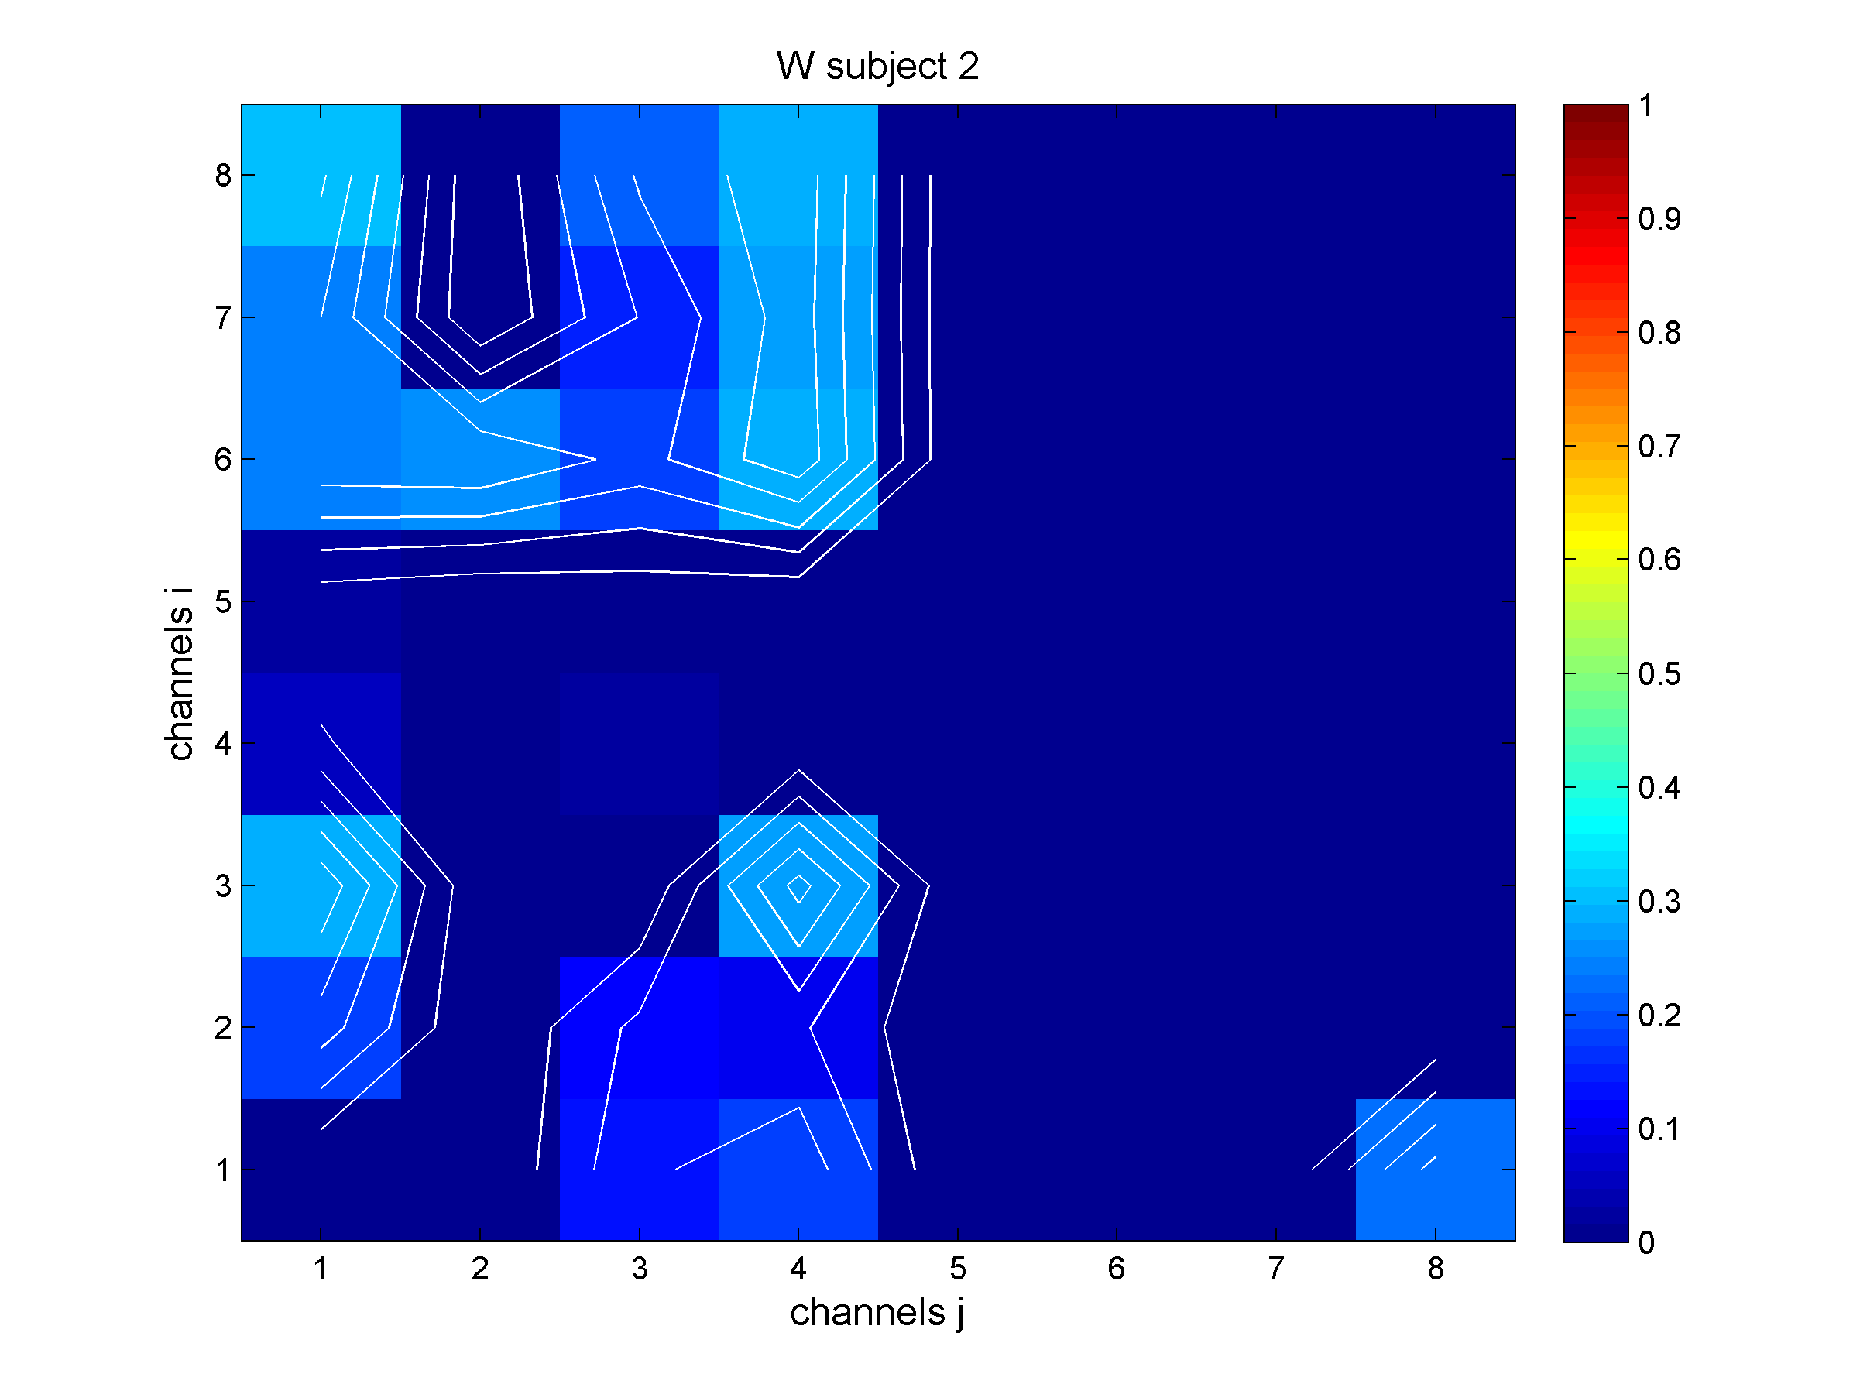
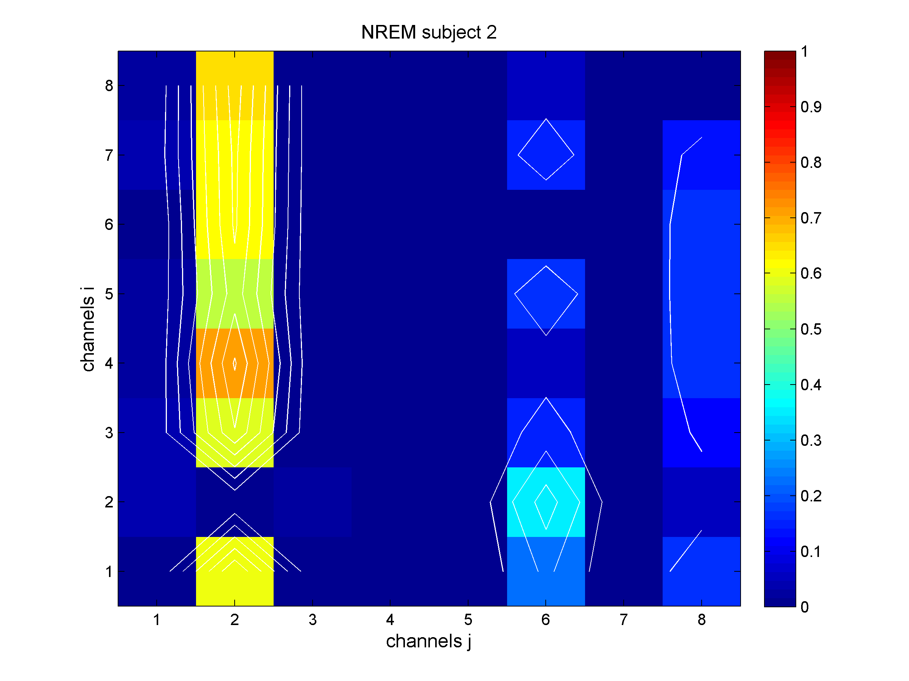
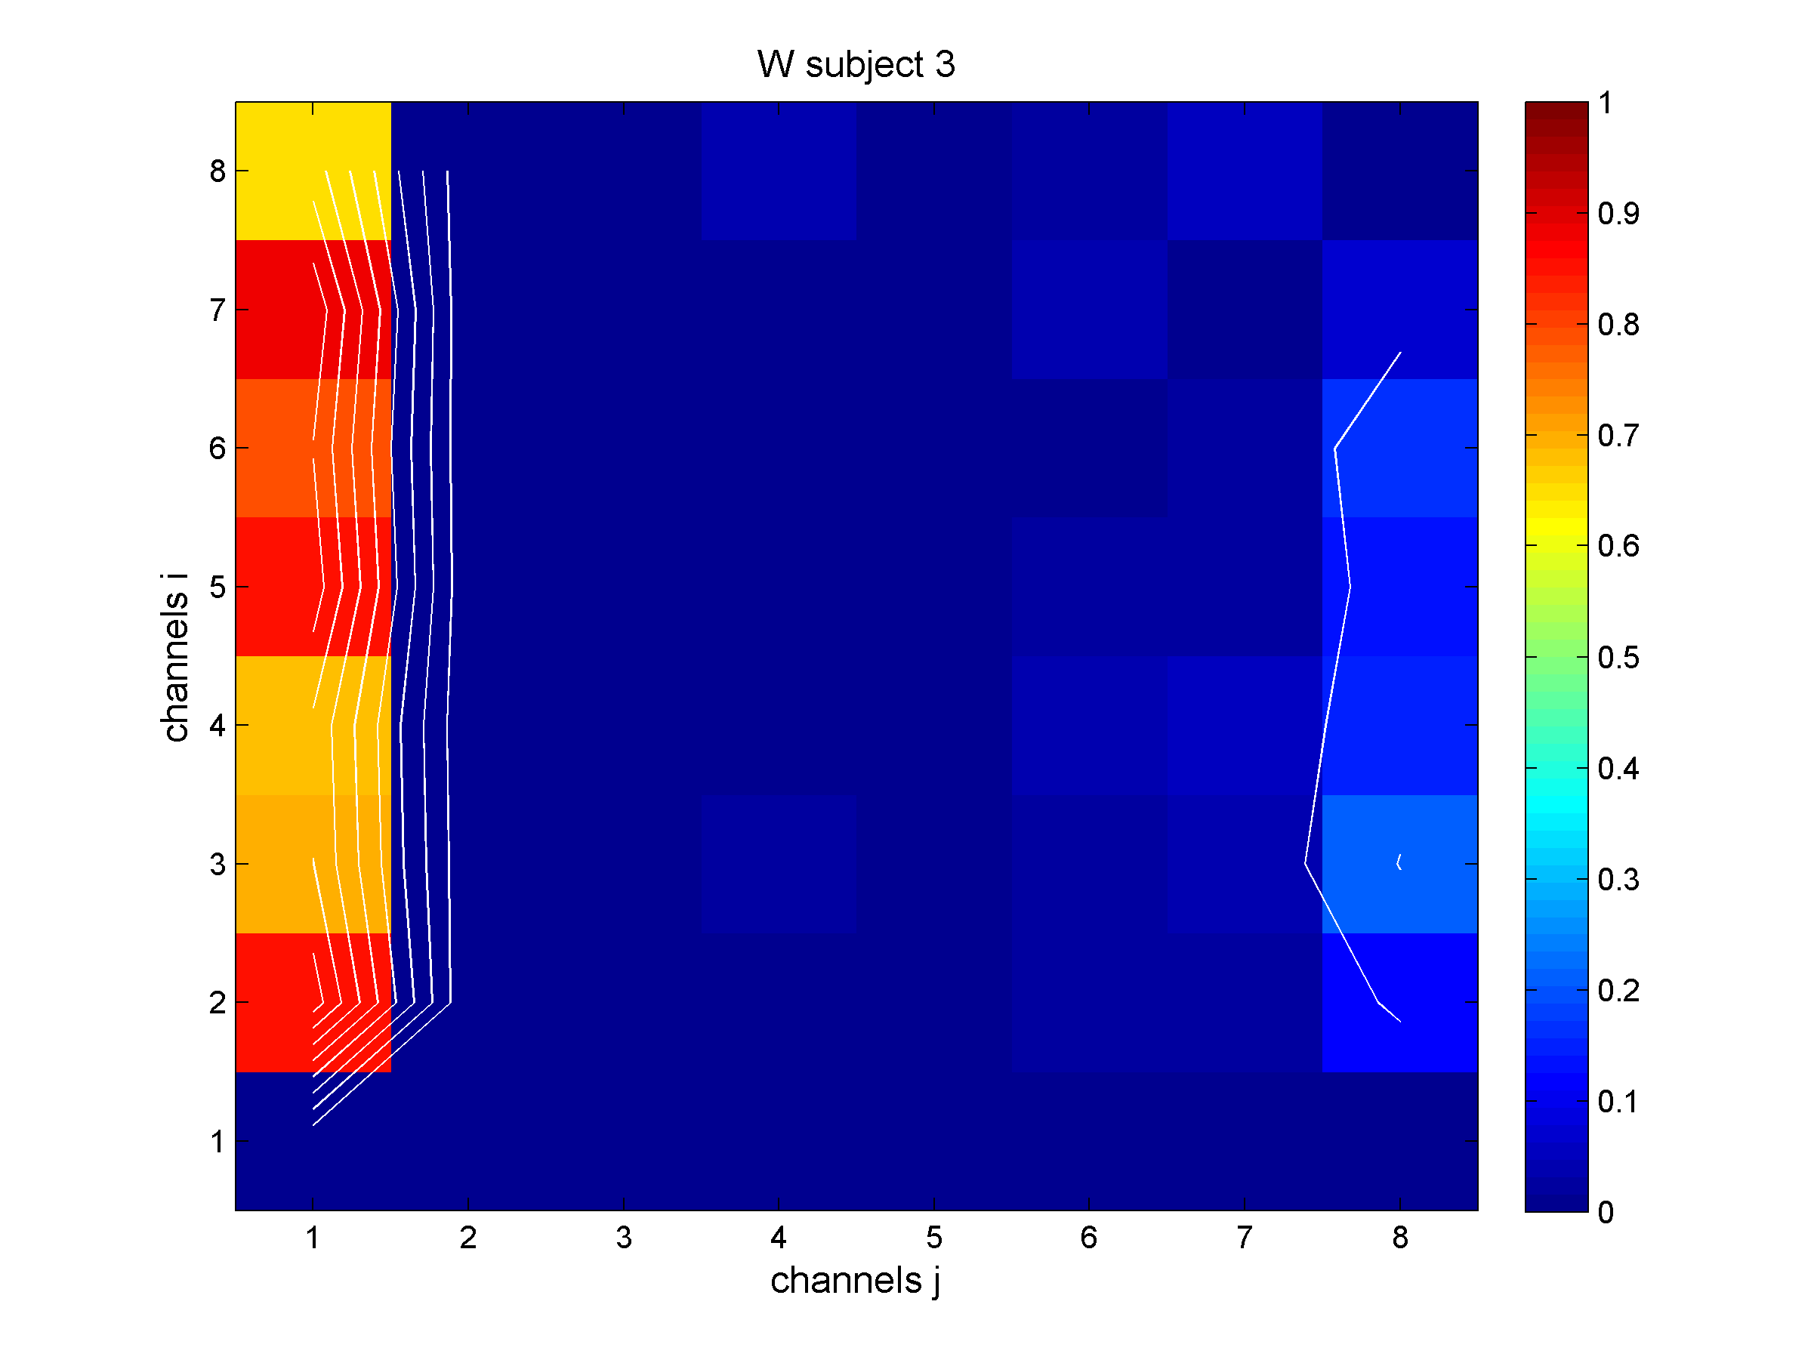
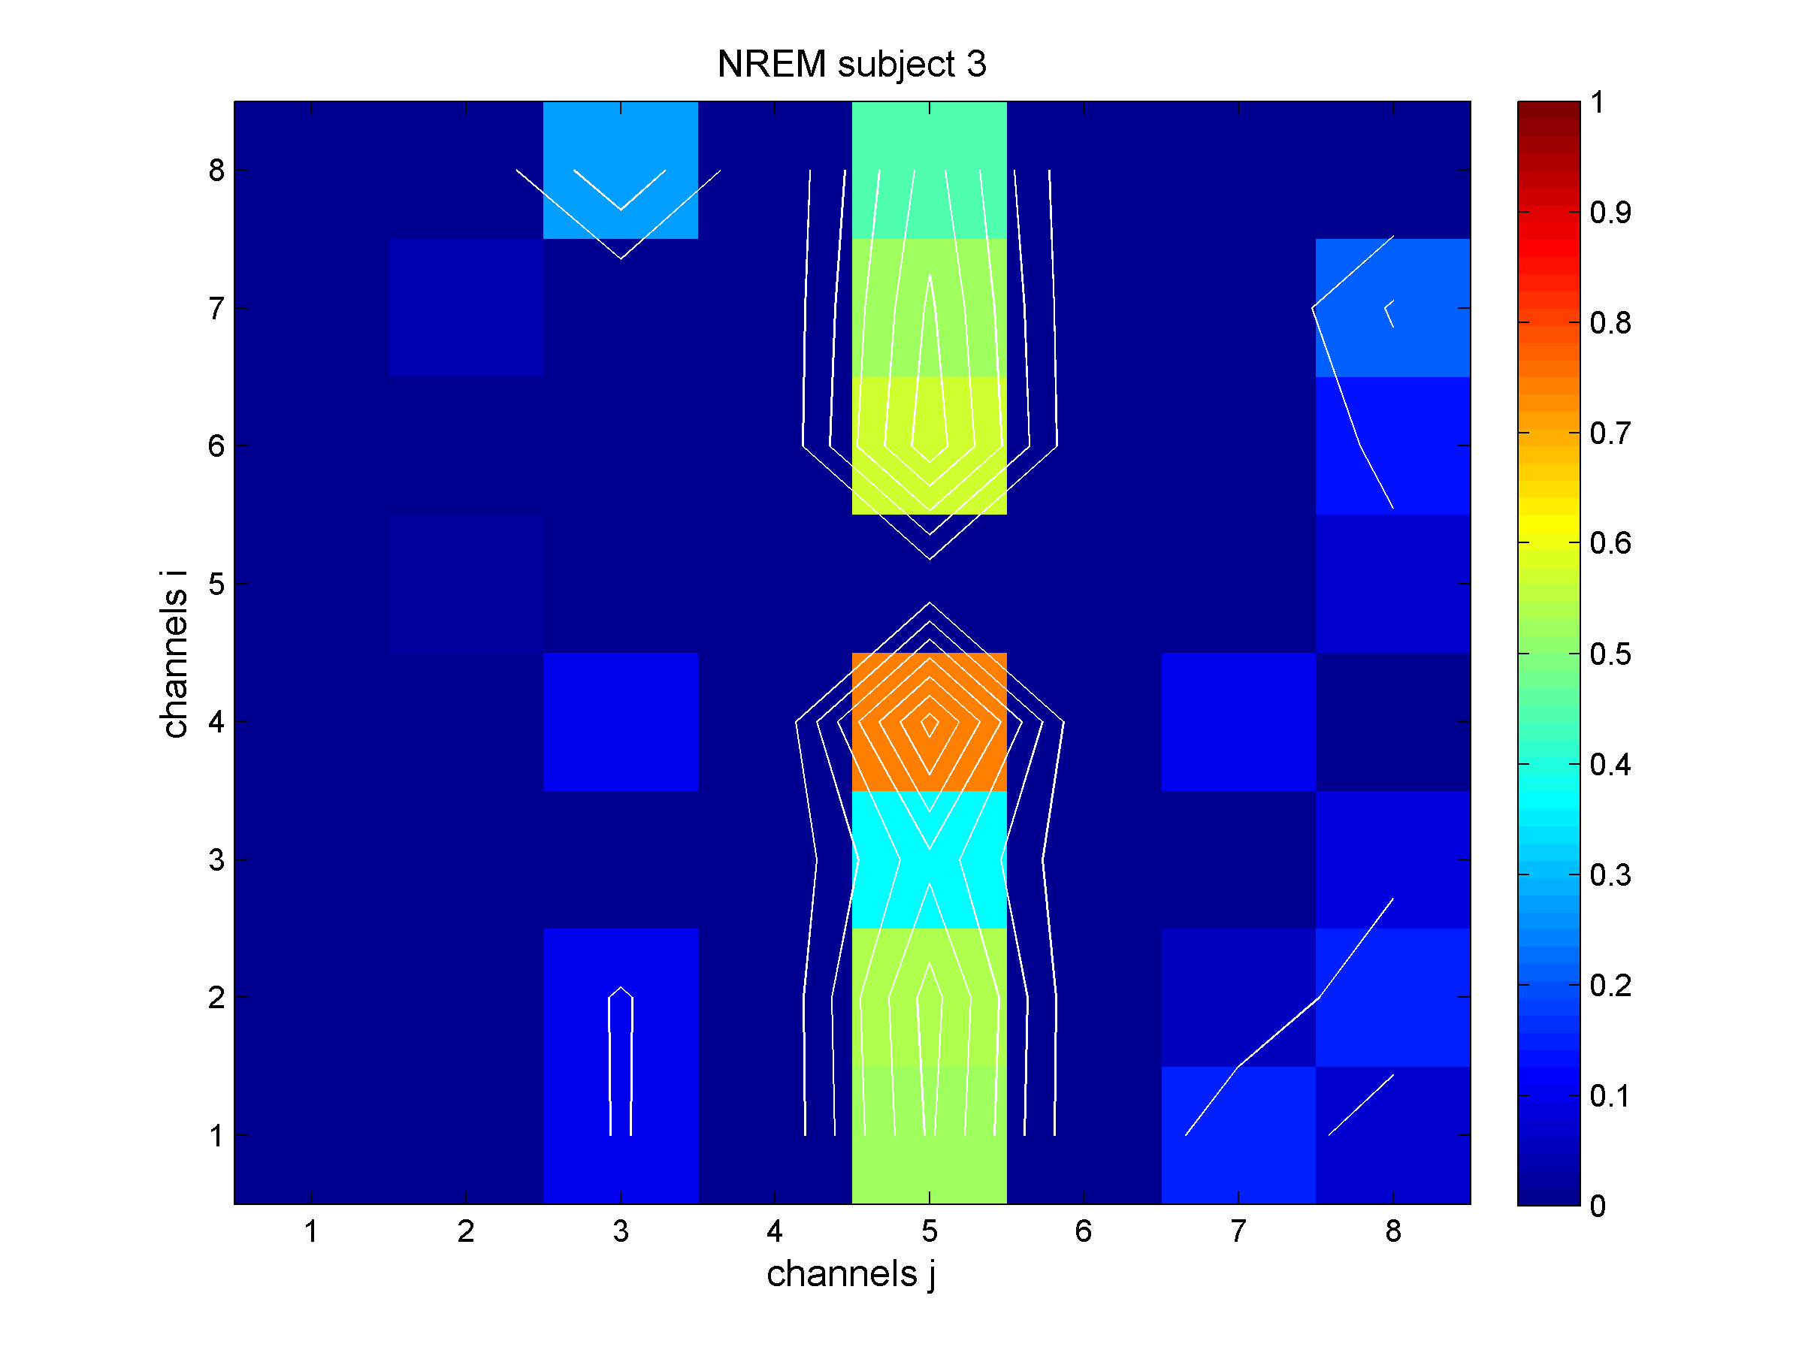
DTF Results
WAKE NREM
Averaged values in Delta Frequency band (0.4 - 5 Hz)
# 1
# 2
# 3
Information flow:
from j to i
DTF values:
WAKE>NREM
p < 0.05
February 27, 2018
Notes:
During slow oscillations( her reported ad Delta frequencies), feature of SLEEP expecially after an eletrical stimulation,
SLEEP and Wake statuses have very few COMMON channels involved: could be that these Uncommon are the peculiar sites (inidicando in wake) for consciousness? Infact the source channels in wake with higher intensity of connection are localized in Brodmann (that has the function to produce a meaningful perceptual experience, enable us to interact effectively, and support abstract thinking and language) and parietal area (that has the function of integrate sensory information and information stored in memory)
A quantitative assessment indicates that 4 over 5 subjects show higher DTF values in WAKE than NREM, again..opposite then expected

Slide 20
DTF Results
Connections in Gamma Band |  | Connections in Delta Band
# 1
# 2
WAKE
NREM
February 27, 2018
Notes:
In the previous two slides the two statuses (WAKE and NREM) are compared. In this slide a comparison is added: we have the comparion between the frequency bands and between states. Arrow in yellows show directional connection in conscious state, in blu the uncoscious one.
We did not find a common path able to explain different behavior. Also considering macro areas of the brain it was not possible to define a common direction of the information flow.
Interesting is that, in gamma band, the connections have the same direction in both conscious states (giallo e blu hanno stessa direzione). The opposite happens in Delta way where networks have opposite directions.—this coul be an indication for the re-elaboration work of our memory during night
Also the distances between nodes and the location of contacts with regard to the stimulation site do not lead to common conclusion.

Slide 21
DTF Results
DTF analysis :
helped to localize sinks, sources, and locations of the major players of the network (Brodman and parietal area)
the information flow swapped direction only in Delta: is this the re-elaboration role of brain during night?
Interesting findings: higher DTF values are observable: i) in WAKE for DELTA frequencies and ii) in NREM for GAMMA frequencies (opposite then expected)
February 27, 2018
Notes:
leggo

Slide 22
Methods
Type of Analysis | Methods | Main Aims
Connectivity Considering two frequency bands: Delta and Gamma | Directed Transfer Function (DTF) | Analyze the functional meaning of the adoption of re-reference styles Evaluate brain network changes linked to the consciousness
 | Adaptive DTF (Time Varying ) (ADTF) + Statistical Analysis (ANOVA/MANOVA) | Investigate the role of the reactivation phenomenon (down-state) Evaluate brain network changes linked to the levels of consciousness
Feature Extraction (FE) | Standard Deviation vs Wavelet coefficients + ANN classification. | Classify WAKE/NREM sleep states
February 27, 2018
Notes:
How much the re-referencing style can affect the connectivity result?
We performed DTF analysis using 3 different re-referencing syles..

Slide 23
Re-referencing style: Results
Referential montage: every single intracranial channel was referenced to a single channel placed into the white matter (electrically inactive)
Bipolar re-referencing (BP)=subtraction of the signal from the adjacent contact
Common Average (MA)=the mean value of every voltage from all channels is subtracted
Closest white (CW)= referenced to the closest white-matter electrodes (Arnulfo et al., 2015)
February 27, 2018
Notes:
SEEG recordings were analysed with a referential montage in which every single intracranial channel was referenced to a single channels placed into the white matter (electrically inactive).
We compared:
Bipolar (BP), Moving average (MA), closest white contact (CW) montages
The most commonly used in literature is bipolar one . We adopted this method to avoid additive variables in our studies.
BP minimizes common electrical noise and it maximizes spatial resolution, but one limitation is the removing or the alteration of information common to the two referential time-series.
common average [87] (MA): the mean value of every voltage from all channels is subtracted performing a spatial formatting to reduce differences in amplitude.
Our initial choice was to do not apply a re-referential montage. Monopolar montage (without a re-referencing step) is preferred for evaluating possible connections between distant areas, in fact the spatial specificity of the recordings is preserved when using monopolar approach can produce a spectral power map influenced by reference activity . BUT its limitations is the fact that the referential montage can produce a spectral power map influenced by reference activity . So, investigating the literature we found
Arnulfo et al. [48] paper where they proposed a novel reference method where electrodes into the grey-matter are referenced to the closest white-matter electrodes (CW), where the white contact is “silent”. CW montage has similar characteristics of MP but its limitation due to volume conduction seems to be overcome

Slide 24
Re-referencing style: Results
subject | min | max | threshold | main | source | sink
1 | 0 | 0,210214 | 0,199703 | 0,210214 | 4 | 2
2 | 0 | 0,301177 | 0,286118 | 0,301177 | 2 | 6
3 | 0 | 0,071934 | 0,068337 | 0,071934 | 7 | 8
4 | 0 | 0,190279 | 0,180765 | 0,190279 | 5 | 7
5 | 0 | 0,214859 | 0,204116 | 0,214859 | 5 | 7
BP montage
subject | Min | Max | threshold | main | source | sink
1 | 0 | 0,173092 | 0,164437 | 0,173092 | 4 | 1
2 | 0 | 0,279753 | 0,265766 | 0,279753 | 6 | 7
3 | 0 | 0,366743 | 0,348406 | 0,366743 | 1 | 7
4 | 0 | 0,363329 | 0,345163 | 0,363329 | 6 | 4
5 | 0 | 0,26004 | 0,247038 | 0,26004 | 5 | 7
 |  |  |  | 0,251454 | 5 | 8
Re-referencing method deeply influences the result
CW montage
subject | min | Max | threshold | main | source | sink
1 | 0 | 0,468768 | 0,445329 | 0,468768 | 4 | 7
2 | 0 | 0,298803 | 0,283863 | 0,298803 | 8 | 7
3 | 0 | 0,500054 | 0,475051 | 0,500054 | 1 | 3
4 | 0 | 0,381167 | 0,362109 | 0,381167 | 5 | 1
5 | 0 | 0,380565 | 0,361536 | 0,380565 | 2 | 4
 |  |  |  | 0,37959 | 4 | 2
MA montage threshold : 95°percentile
February 27, 2018
Notes:
main connection, over the threshold (95°percentile) for each subject (1:5) are reported
It is immediately observable that the connections involved in the three re-referencing styles are often not comparable. Results also varied in respect of the signal dataset of every subject. The usage of a specific montage has to be selected according to the type of analysis to be performed [96]. These results corroborate the idea that the method re-referencing deeply influence the result.
CW and MA montages appear to provide more similar results with respect to BP.
We have a better confidence in CW montage (published by Arnulfo et al. [48]) because it has the same benefits of the unipolar montage together with less drawbacks.

Slide 25
Methods
Type of Analysis | Methods | Main Aims
Connectivity Considering two frequency bands: Delta and Gamma | Directed Transfer Function (DTF) | Analyze the functional meaning of the adoption of re-reference styles Evaluate brain network changes linked to the consciousness
 | Adaptive DTF (Time Varying ) (ADTF) + Statistical Analysis (ANOVA/MANOVA) | Investigate the role of the reactivation phenomenon (down-state) Evaluate brain network changes linked to the levels of consciousness
Feature Extraction (FE) | Standard Deviation vs Wavelet coefficients + ANN classification. | Classify WAKE/NREM sleep states
February 27, 2018
Notes:
Going on
netx results are obtained by Adaptive directed transform function where the main aim is to investigate the downstate and the presence of the reactivation phenomenon.

Slide 26
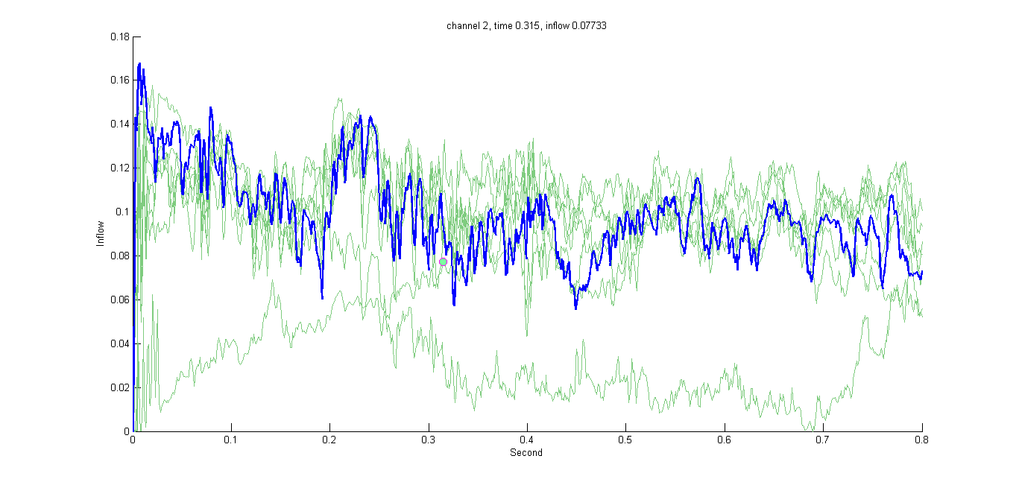
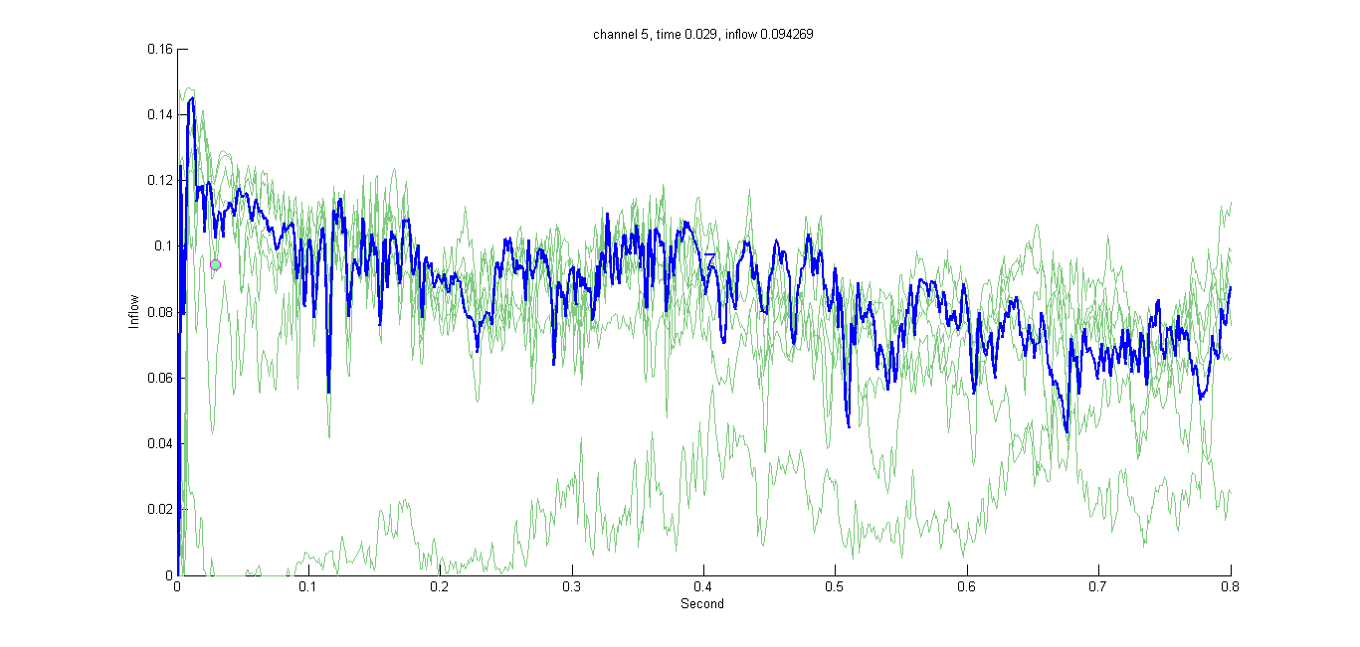
ADTF Results
Pigorini et al, 2015
WAKE
NREM
̴150 ms : ̴500 ms
Inflow
Inflow
Time (s)
Time (s)
Time-Varying Inflows
February 27, 2018
Notes:
Here I show the ADTF plots , where in y axis there is the inflow and on x axis the time (ms)
SignalS from many channel are reported, we colored just one in blue to follow its changes.
We worked on the portion of the signal outlined by the red box because this is the time window in which the re activation phenomenon is expected
We proceeded creating two windows on ADTF values (lasting 100 ms each) containing ADTF values: one immediately before the known down-state point (orange ) and the other one immediately after (yellow).

Slide 27
ADTF Results
4D matrix -> Descriptive Feature
4D.matrix(time, sink, source, frequency)
3D.matrix(time, sink, source): mean over frequency
2D.matrix(time, sink): influence of all sources in every sink
A descriptive feature (ADTF mean value over time) for every sink
February 27, 2018
Notes:
We calculated the frequency mean obtaining a 3D matrix (ADTF.matrix (time, sink, source)), then we calculated the influence of all source channels in each sink channel obtaining a 2-D matrix . As last step, the mean was extracted from values in time, and this mean for each sink channel was considered as a descriptive feature and utilized in statistical analysis.
We worked on sink, an so on inflow, to test the hypothesis that the re-activation is given by a feedback activity (directional switching) from the network.

Slide 28
ADTF Results
Experiments designed considering 4 INPUT groups of 40 elements each (all patients and all electrodes pooled).
ADTF values were extracted from the windows :
BEFORE the down-state in WAKE
AFTER the down-state in WAKE
BEFORE the down-state in NREM
AFTER the down-state in NREM
WAKE
Time (s)
February 27, 2018
Notes:
Given that the down-state is not peculiar of i) a single subject or ii) some particular channels or iii) particular position of the channels, but is peculiar of NREM situation, we pooled data of all patients and all electrodes. The only distinction taken into account was the conscious state. We designed the experiment considering 4 groups of 40 elements each (40 means of ADTF values). The four groups (later called INPUT groups) were:
Means of ADTF values calculated on the window BEFORE the down-state in WAKE situation;
Means calculated on the window AFTER the down-state in WAKE situation;
Means calculated on the window BEFORE the down-state in NREM situation;
Means calculated on the window AFTER the down-state in NREM situation

Slide 29
ADTF Results
Analysis of variance (ANOVA):
Pairwise comparison of the groups mean
The two-way ANOVA that compares the mean differences between groups that have been split in two independent variables A,B
Variable A (rows): feature for each observation; Variable B (columns): conditions (WAKE/NREM, BEFORE/AFTER)
February 27, 2018
Notes:
We aimed to test if some conditions (BEFORE/AFTER the down-state corresponding to a particular conscious state) have significantly higher means than others.
For the significance evaluation we applied Analysis of variance (ANOVA), where the null hypothesis was that all the averages do not differ from each other. In particular we adopted The two-way ANOVA that compares the mean differences between groups that have been split on two independent variables (factors). The two-way ANOVA tests hypotheses about the effects of factors A and B, and their interaction on the response variable where A are the mentioned features and B the organization in WAKE/sleep/before/AFTER

Slide 30
ADTF Results
BOXPLOT
Delta Band | Gamma Band
4 Groups: 1) Before/WAKE condition; 2) After/WAKE condition; 3) Before/NREM condition ; 4) After/NREM condition
Means
Means
Groups
Groups
Condition effect: p < 0.01 Inter-patients variability: p < 0.01 | Condition effect: p < 0.01 Inter-patients variability: p < 0.01
February 27, 2018
Notes:
Boxplot of means distribution
ANOVA matrix is composed by condition (in columns) and ADTF values from all channels (in rows)
p-value is very low both considering condition and ADTF values (inter patients variability). This indicates that one factor (in both variables) is out-performing the other

Slide 31
ADTF Results
Delta Band | Gamma Band
4 Groups: 1) Before/WAKE condition; 2) After/WAKE condition; 3) Before/NREM condition; 4) After/NREM condition
MULTI-COMPARISON BETWEEN GROUPS
Before vs After!
Groups
Re-activation!
Groups
Means
Means
Group 2 differs from all (p <0,0001) | Group 1 differs from Group 2 (p =0,0477) Group 1 differs from Group 4 (p =0,0028) Group 3 differs from Group 4 (p=0.0178)
February 27, 2018
Notes:
On the left
Group 2 (BLUE BAR) (means in WAKE condition calculated in the window following the down-state) differs from all the other three groups (RED ONES) (p<0.00001 in all the comparisons). Group 2 is peculiar of the consciousness state: in fact, the means are calculated from the windowed data where the re-activation phenomenon is awaited. As expected, Group 2 differs from Group 4 where a completely different behaviour of the network is forecast.
On the right
Group 1 (means in WAKE condition calculated in the window before the down-state) differs from the Group 2 (p=0.0477) and from the Group 4 (p= 0.0028).
In gamma frequency band the difference is considering what happens before and after the downstate: Connectivity before and after the down-state changes in WAKE but also in NREM state

Slide 32
ADTF Results
ADTF/ANOVA analysis confirms:
A different behaviour in WAKE with respect to NREM during slow oscillations (DELTA band) and after the downstate
Interestingly, changes into the network do not occur only in Delta, but also in Gamma Band ( the result is not reported in literature):
Even if the re-activation is peculiar of slow waves, a different behaviour, during time, is detectable also in Gamma band
February 27, 2018
Notes:
Leggo

Slide 33
Methods
Type of Analysis | Methods | Main Aims
Connectivity Considering two frequency bands: Delta and Gamma | Directed Transfer Function (DTF) | Analyze the functional meaning of the adoption of re-reference styles Evaluate brain network changes linked to the consciousness
 | Adaptive DTF (Time Varying ) (ADTF) + Statistical Analysis (ANOVA/MANOVA) | Investigate the role of the reactivation phenomenon (down-state) Evaluate brain network changes linked to the levels of consciousness
Feature Extraction (FE) | Standard Deviation vs Wavelet coefficients + ANN classification. | Classify WAKE/NREM Sleep states
February 27, 2018
Notes:
Going on
we applyed another method to the same dataset: we performed feature extraction

Slide 34
Feature Extraction: Aim
Connectivity Analysis :
Identified different network behaviors in the two states
Measured the information flows
Revealed the direction of information according to the role of some brain areas
Feature Extraction method:
To examine how signals vary according to the conscious conditions, we extracted a set of features and we identified the one that allows to differentiate WAKE vs NREM
February 27, 2018
Notes:
Leggo
With…

Slide 35
Feature Extraction: Method
Channels selection criteria: the ones with maximum absolute difference between the two conditions
Features extraction :
coefficients from Wavelet decomposition (Ca, Cd6)
STD values
Classification:
Artificial Neural Network (MPL).
ROC (Receiver Operating Characteristic) to evaluate the performance of the classifier.
February 27, 2018
Notes:
leggo
We determined the most meaningful channel computing the standard deviation (STD) for each epoch and channel. maximum absolute difference, considering the median STD values, between the two WAKE and NREM conditions.
We performed Wavelet decomposition (Daubechies mother wavelet, level 6, order 4) to increase the frequency resolution and to obtain other features from each channel
We employed an Artificial Neural Network (Multilayer Perceptron mi sembra, controlla) as a classification method. We applied the ROC (Receiver Operating Characteristic) curve to evaluate the performance of the classifier.
We tested with the ANN a combination of features (STD, Ca, Cd6) in order to detect which one was capable of differentiating NREM and WAKE. Sensitivity (Se), Specificity (Sp) and Accuracy (Acc) were computed for each combination.

Slide 36
Feature Extraction: Results
 | Performance (%)
Features | Accuracy | Specificity | Sensitivity
STD | 82,84±13,14 | 70,87±33,81 | 87,51±16,30
Ca | 95,71±9,65 | 92,5±16,87 | 100±0,00
Cd6 | 92,85±10,11 | 88±17,35 | 96,67±10,53
Ca+STD | 98,57±4,52 | 96,67±10,53 | 100±0,00
Cd6+STD | 98,57±4,52 | 97,5±7,91 | 100±0,00
Ca+Cd6 | 98,57±4,52 | 96,67±10,53 | 100±0,00
ANN classification: Average and standard deviation evaluated on the test set, computed over 10 runs (Sensitivity: the true recognition of wakefulness).
Average and standard deviation of AUC t test
of the NN outputs computed over 10 runs
wavelet
 | AUC
STD | 0,9389±0,063
Ca | 0,9986±0,003
Cd6 | 0,9967±0,006
Ca+STD | 0,9960±0,012
Cd6+STD | 0,9998+0,001
Ca+Cd6 | 0,9934±0,018
 | t | p-value
Ca vs STD | 3.143 | 0.006
Cd6 vs STD | 3.042 | 0.007
Ca+STD vs STD | 2.957 | 0.008
Cd6+STD vs STD | 3.126 | 0.006
Ca+Cd6 vs STD | 2.725 | 0.014
Rutigliano et al.,2018
February 27, 2018
Notes:
Ca, Cd6 (approximation and detail coefficients from wavelet) got similar accuracy performances in ANN classification, 95.71% and 92.85% respectively; the accuracy resulted to be higher when Ca and Cd6 are combined with STD or between them (98.57%) (Table 8).
t-test on AUC values gave the following information (Table 9):
The AUC calculated on each NN output demonstrated the high performances of the ANN
Analyzing the AUC results, we derived some interesting considerations from the comparison between parameters: there was no significant difference between Ca and Cd6 performances; and (3) the associations of more features did not improve the classification performances with respect to Ca or Cd6 alone.

Slide 37
Feature Extraction: Results
Found of composition of features that is able to recognize WAKE or NREM states with very good discrimination performances using one single iEEG electrode
Evaluation of anatomical regions capable of differentiating the two conditions
February 27, 2018
Notes:
leggo

Slide 38
Conclusions
Because of the iEEG technique’s limitations, the variability of the results, that depends on the inter-patients variability and on the methods used (both re-reference and analysis), a satisfying understanding of brain connectivity and the ability to distinguish states of consciousness and unconsciousness is still a work in progress.
February 27, 2018
Notes:
Leggo

Slide 39
Conclusions
This work offers a first experimental approach toward distinction and characterization of WAKE/NREM states using a human dataset that provides excellent spatial and temporal resolution
February 27, 2018
Notes:
Leggo
BUT..

Slide 40
Conclusions
We proved the following combination of methods, analysis and statistics to be valid and useful:
the downstate presence and the re-activation phenomenon was revealed by means of computational techniques (ADTF + ANOVA)
wavelet coefficients are valid parameters able to differentiate the states
Notes:
Infact we proposed a ...
We revealed the presence of the....

Slide 41
Conclusions
The DTF analysis, interesting findings:
the information flow swapped direction only in Delta: can this explain the re-elaboration role of brain during night for memory consolidation?
higher DTF values are observable: i) in WAKE for DELTA frequencies and ii) in NREM for GAMMA frequencies (opposite then expected)
re-referencing style produces different connectivity results: it deeply influences any following analysis

Slide 42
Conclusions
ADTF/ANOVA analysis interesting findings:,:
Confirmed the presence of re-activation effect only in WAKE and during slow oscillations (DELTA)
Revealed interesting changes in the network, according to the downstate time, not only during Delta, but also in Gamma frequency in both NREM and WAKE states.

Slide 43
Thank you for the attention
February 27, 2018

Slide 44
Cited references
A. R. Antony, A. V. Alexopoulos, J. A. Gonzalez-Martinez, J.C. Mosher, L. Jehi, R. C. Burgess, N. K. So, and R. F. Gala, “Functional Connectivity Estimated from Intracranial EEG Predicts Surgical Outcome in Intractable Temporal Lobe Epilepsy,” PLoS One, vol. 8, no. 10, pp. 1–7, 2013.
J. Schrouff, V. Perlbarg, M. Boly, G. Marrelec, P. Boveroux, A. Vanhaudenhuyse, M. A. Bruno, S. Laureys, C. Phillips, M. Pélégrini-Issac, P. Maquet, and H. Benali, “Brain functional integration decreases during propofol-induced loss of consciousness,” Neuroimage, vol. 57, no. 1, pp. 198–205, 2011.
R. Matsumoto, D. R. Nair, E. LaPresto, I. Najm, W. Bingaman, H. Shibasaki, and H. O. Lüders, “Functional connectivity in the human language system: A cortico-cortical evoked potential study,” Brain, vol. 127, no. 10, pp. 2316–2330, 2004.
A. Brovelli, M. Ding, A. Ledberg, Y. Chen, R. Nakamura, and S. L. Bressler, “Beta oscillations in a large-scale sensorimotor cortical network: directional influences revealed by Granger causality.,” in Proceedings of the National Academy of Sciences of the United States of America, 2004, vol. 101, no. 26, pp. 9849–9854.
M. Massimini, F. Ferrarelli, S. Sarasso, and G. Tononi, “Cortical mechanisms of loss of consciousness: Insight from TMS/EEG studies,” Arch. Ital. Biol., vol. 150, no. 2–3, pp. 44–55, 2012.
A. Pigorini, S. Sarasso, P. Proserpio, C. Szymanski, G. Arnulfo, S. Casarotto, M. Fecchio, M. Rosanova, M. Mariotti, G. Lo Russo, M. J. Palva, L. Nobili, and M. Massimini, “Bistability breaks-off deterministic responses to intracortical stimulation during non-REM sleep,” Neuroimage, vol. 112, pp. 105–113, 2015.
B. He, Y. Dai, L. Astolfi, F. Babiloni, H. Yuan, and L. Yang, “EConnectome: A MATLAB toolbox for mapping and imaging of brain functional connectivity,” J. Neurosci. Methods, vol. 195, no. 2, pp. 261–269, 2011.
G. Arnulfo, J. Hirvonen, L. Nobili, S. Palva, and J. M. Palva, “Phase and amplitude correlations in resting-state activity in human stereotactical EEG recordings,” Neuroimage, vol. 112, pp. 114–127, 2015.
T. Rutigliano, M. W. Rivolta, P. Rita, and S. Roberto, “Composition of Feature Extraction Methods Shows Interesting Performances in Discriminating Wakefulness and NREM Sleep,” IEEE Signal Process. Lett., vol 25, pp 204-208, 2018.
February 27, 2018

Slide 45
Publications during Ph.D. program
Teresa Rutigliano, Massimo Walter Rivolta, Rita Pizzi, Roberto Sassi. Composition of Feature Extraction Methods Shows Interesting Performances in Discriminating Wakefulness and NREM Sleep. Signal Processing Letter, Volume 25, 2018, Pages: 204-208
Rita Pizzi, Teresa Rutigliano, Marialessia Musumeci, Massimo Pregnolato. Using Granger Causality to Assess the Interaction between Brain Areas during Different Consciousness States. International Journal of Biology and Biomedical Engineering, ISSN: 1998-4510, Volume 10, 2016, Pages: 241-217.
Francesco Broccolo, Chiara Tassan Din, Maria Grazia Viganò, Teresa Rutigliano, Susanna Esposito, Paolo Lusso, Giuseppe Tambussi, Mauro S. Malnati. HHV-8 DNA Replication Correlates with the Clinical Status in AIDS-Related Kaposi’s Sarcoma. Journal of Clinical Virology, Volume 78, 2016, Pages: 47-52
Rita Pizzi, Teresa Rutigliano, Alessio Ferrarotti, Massimo Pregnolato. A computational Simulation of the Interaction between Immune and Neuroendocrine Systems. International Journal of Biology and Biomedical Engineering, ISSN: 1998-4510, Volume 9, 2015, Pages: 48-55
Rita Pizzi, Teresa Rutigliano, Alessio Ferrarotti, Massimo Pregnolato. Computational Study on the Binding Affinity Between Microtubules and Consciousness-Altering Substances. International Journal of Biology and Biomedical Engineering, ISSN: 1998-4510, Volume 9, 2015, Pages: 75-82
Rita Pizzi, Teresa Rutigliano, Pietro Guadalupi, Massimo Pregnolato. Molecular Cooperation to Reinforce Immune Response during Carcinoma: A Structural Bioinformatics Analysis. Proceedings of 8th Int. Conf. on Applied Mathematics, Simulation and Modeling, Firenze, November 2014, Pages: 22-24
Rita Pizzi, Teresa Rutigliano, Alessio Ferrarotti, Massimo Pregnolato. Computational Prediction of Binding Affinity between Psychotropic Drugs and Neural Cytoskeleton Elements. Proceedings of 8th Int. Conf. on Applied Mathematics, Simulation and Modeling, Firenze, November 2014, Pages: 22-24
February 27, 2018

Slide 46
Posters in conferences
Rita Pizzi, Teresa Rutigliano, Marialessia Musumeci. Mapping and Coding Functional Dynamics of Consciousness States. Poster Session. Neuronest: Primo Meeting Traslazionale del Gruppo di Ricerca Strategico in Neuroscienze de “La Statale”. Sala Napoleonica-Università degli Studi di Milano, Milano, Marzo, 2017
Rita Pizzi, Teresa Rutigliano, Marialessia Musumeci. Shaping a Set of Oriented Connections among Brain Areas by Comparison between Coherence and Granger Causality. Poster Session. 37th Annual International Conference of the IEEE Engineering in Medicine and Biology Society. MiCo - Milano Conference Center - Milan, Italy, August 25-29, 2015

Slide 47
Future works
Further investigaton on the temporal slices used in ADTF analysis
Enhance data robustness: increasing the number of i) subjects and ii) channels
Play with other conditions (time series lenght, frequency ranges..)
Detect the down state point by means of computational techniques (e.g. feature extraction)
Confirm the presence of the re-activaton and downstate phenomena also in the case of other re-refencing syles (e.g. CW)
February 27, 2018

Slide 48
Tools
Type of Analysis | Tools
Connectivity | Data extraction and Preprocessing: Ad hoc Matlab script DTF/ADTF values calculation: eConnectome toolbox He et al, 2011 Visualization, analysis, statistics: Ad hoc Matlab script
Feature Extraction (FE) | Std and Wavelet analysis: Ad hoc Matlab script Neural network classification: NN pattern recogniton Matlab’s tool
February 27, 2018

Slide 49
Limitations
SPES-iEEG analysis, and EEG analysis in general, suffer from the following limitations:
the data type
the experimental protocol
the preprocessing step
non-stationarity of signals
high inter-patient variability
February 27, 2018

Slide 50
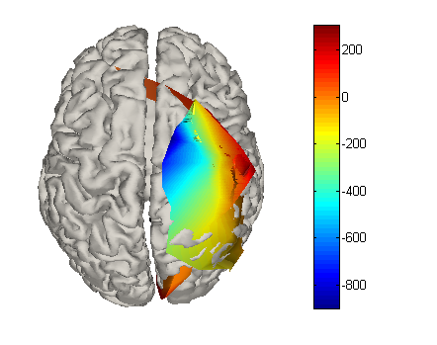
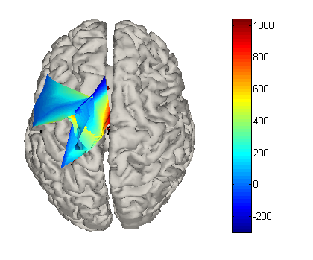
Dataset: limitations
1
2
3
4
5
February 27, 2018
Notes:
This technique is the gold standard method to obtain precise spatial and temporal indications of signals ..but it has some limitations ..
We selected some interesting physiological channels for every subject, we try to select the ones located in similar areas trying to obtain reproducible inter-patients results. The task was not easy because electrode site implantations were chosen purely on clinical needs on epileptic patients and based on the suspected seizure locations (e.g. electrodes are often implanted only on one hemisphere, that could not be the same for all the patients).

Slide 51
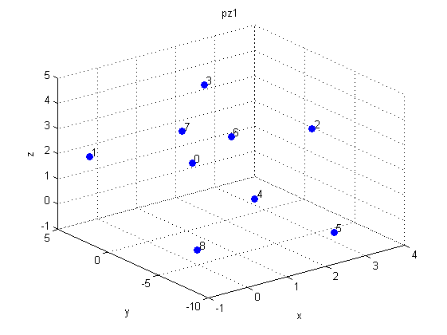
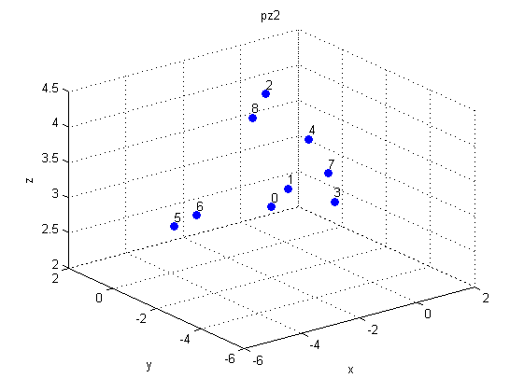
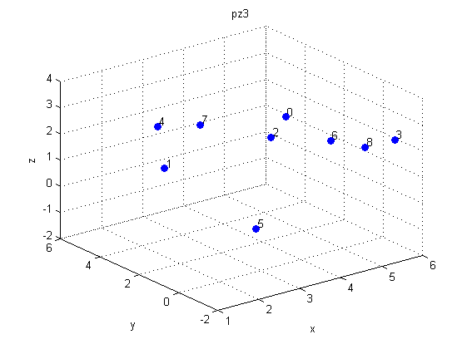
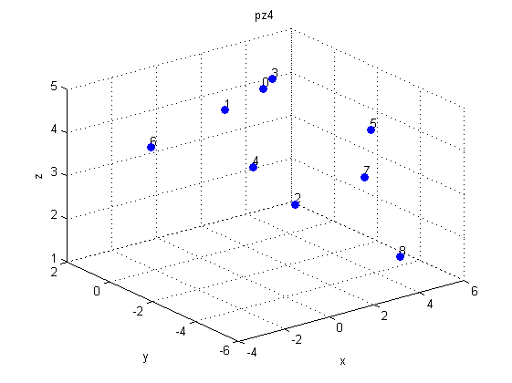
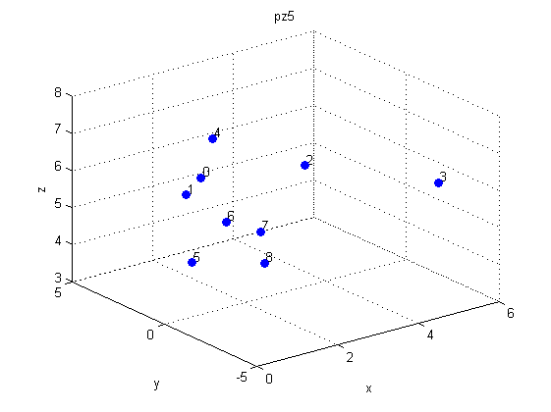
Dataset: limitations
February 27, 2018
Notes:
2) The dataset included several acquisition sessions, in each session the stimulation point (channel source of electrical induction) was different, and meanwhile the other contacts (up to 189) were used to collect data. here positions of stimulation sites are shown in red and it is clear that they vary for every subject
3) Patients soffers by pharmacological resistant epilepsy and are treated with drugs
Thus a strong variability inter patients is forecast
The research was carried out on the base of these bounds

