Slide 1
Functional Programming in a Nutshell with Haskell and F#
Giordano Tamburrelli, PhD
Academic Developer Evangelist
giotam@microsoft.com
DPE – Microsoft Italia

Slide 2
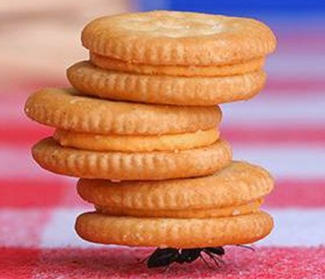
Agenda
Intro
Course Overview
Topics and evaluation
Functional Languages
One upon a time
What, why and how
….
Giordano Tamburrelli, Phd

Slide 3
One slide about me
PhD in Software Engineering @ Politecnico di Milano
Service Oriented Architectures
Software Performance and Reliability
Cloud Computing (recently)
Academic Developer Evangelist at Microsoft Italia
Dreamspark
MSDN Academic Alliance
Imagine Cup
…
Giordano Tamburrelli, Phd

Slide 4
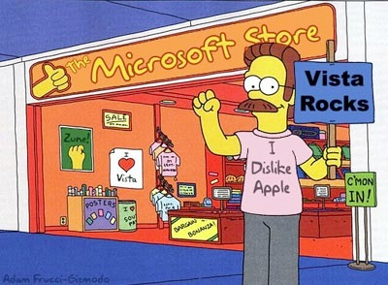
One slide about Microsoft’s initiatives
DreamSpark and MSDN AA
For this course you’ll need:
Visual Studio 2010
F#
XNA 4.0
Giordano Tamburrelli, Phd

Slide 5
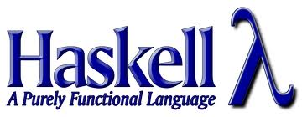
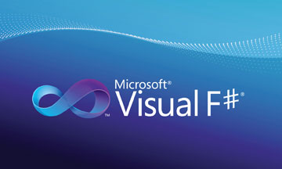
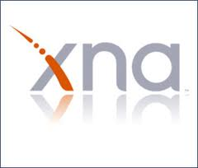
Course Overview 1/3
Introduction to Functional Languages
Haskell in a nutshell
With a focus on concurrency
F# in a nutshell
Hands on session
F# + XNA
Giordano Tamburrelli, Phd

Slide 6
Course Overview 2/3
Goal:
Understand peculiarities, pros and cons associated to functional languages
Evaluation:
Mini-paper (2 pages max) in which you describe how and why functional languages might be useful in your research area.
At most 2 people per paper.
Giordano Tamburrelli, Phd

Slide 7
Course Overview 3/3
What to expect from this presentation:
A brief history of Functional Languages
Functional Languages fundamental concepts
Why Functional Language
Applications of Functional Languages
Giordano Tamburrelli, Phd

Slide 8
Once Upon a time….
First Functional language was ILP (Information Processing Language) by RAND corporation and Carnegie Mellon in 1955 (vs Fortran, 1956)
Lisp was developed John McCarthy at MIT in 1958 (vs Cobol, 1959)
Imperative languages became the dominant paradigm in the 1970s
Mainly academic applications until recently…
Giordano Tamburrelli, Phd

Slide 9
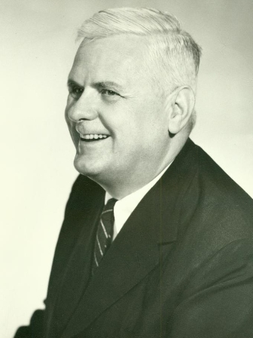
Lambda Calculus
Alonzo Church and Stephen Cole Kleene, in 1936 introduced Lambda Calculus as part of an investigation into the foundation of mathematics
Lambda calculus is a language with three syntactic forms and one reduction rule
Mathematical abstraction, a sort of idealized and minimalistic programming language
The basis of almost all functional programming languages today
Giordano Tamburrelli, Phd

Slide 10
Some interesting readings…
“Can Programming Be Liberated From the von Neumann Style? A Functional Style and its Algebra of Programs”. John Backus, Turing Award lecture, 1977 (available in PDF on-line).
“History of Lisp”. John McCarthy, ACM SIGPLAN History of Programming Languages Conference, 1978.
…
Giordano Tamburrelli, Phd

Slide 11
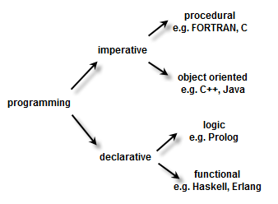
Imperative vs Declarative
Giordano Tamburrelli, Phd

Slide 12
Imperative Programming
Procedural and OO Languages
Variables, assignment and sequencing
Variables = memory locations
Assignments modify variables
Sequencing = extensive use of loops
Imperative Programming as:
State Based
Assignment Oriented
Giordano Tamburrelli, Phd

Slide 13
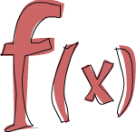
Functional Programming
Functional Programming (FP) is a programming paradigm that treats computation as the evaluation of mathematical functions and avoids state and mutable data (no side effects!)
Variables bound to values!
Recursion in place of iteration
Function composition
Functional Programming as:
Value Based
Applicative
Giordano Tamburrelli, Phd

Slide 14
Functional Programming
These expression are not equal:
//F#
let a = 42
//C#
int a = 42
Conceptually are more like:
//F#
let a = 42
//C#
static int a()
{
return 42;
}
Giordano Tamburrelli, Phd

Slide 15
Functional Programming
Ask don’t tell
Usually we tell the computer how we want things done rather then what we want to achieve (a.k.a. Imperative thinking)
The Espresso example:
If the computer were a coffee maker, we tell the computer to grind the coffee, then get the water and warm it. At the same time prepare the milk, in parallel!
With FP (theoretically), you simply tell (or define) you want an expresso
Giordano Tamburrelli, Phd

Slide 16
Functional Programming
Logical syntax
x = x + 1;
We understand this syntax because we are used to tell the computer what to do and we rely on its internal architecture
But this eqaution does not make no sense at all
Giordano Tamburrelli, Phd

Slide 17
Succinct Syntax
//C#
using System
namespace ConsoleApplication1
{
class Program
{
static int a()
{
return 2;
}
}
}
Giordano Tamburrelli, Phd

Slide 18
Succinct Syntax
//F#
open System
let a = 2
Console.Writeline a
Giordano Tamburrelli, Phd

Slide 19
Some Fundamental concepts
Recursion
High-order functions
Map, Filter, Reduce
Eager/lazy evaluation
Pattern matching (forget your switch statements!)
Currying
Giordano Tamburrelli, Phd

Slide 20
Functional Languages: Why
Recently a lot of hype on Functional Languages
F# initially developed by Don Syme at Microsoft Research. Fully supported language in the .NET Framework and Visual Studio as part of Visual Studio 2010
Clojure introduced in 2007 runs on a JVM
Haskell, Erlang and Scala recently
gained relevant popularity
Giordano Tamburrelli, Phd

Slide 21
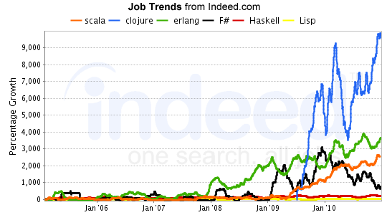
Functional Languages: Why
Giordano Tamburrelli, Phd

Slide 22
Functional Languages: Why
Concurrency/Parallelism without tears
Moore’s law starting to reach its limits
Programmers need to go parallel
No side effects nature
Succinct, concise, understandable syntax
Maintainability
More accessible (e.g., new IDE and tools)
Giordano Tamburrelli, Phd

Slide 23
Applications of FP
Financial Analysis
Insurance Analysis
Advertising Analysis
Image Digital Analysis (Game dev)
Data Mining
Giordano Tamburrelli, Phd

Slide 24
Applications of FP
Erlang
Developed and heavily used by Ericsson for developing large scale real-time systems
F#
Xbox Halo 3 player rankings (lot less code then C#)
Lisp
Autocad
Emacs editor
…
Giordano Tamburrelli, Phd

Slide 25
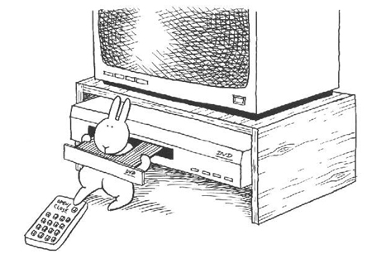
Questions?
A very special thank to:
The speakers
The organizer
Enjoy the course...
Giordano Tamburrelli, Phd

Slide 26
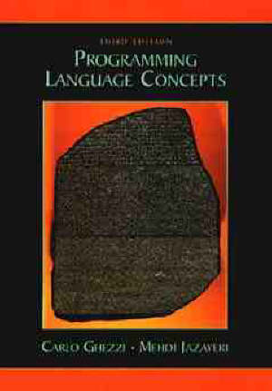
Some References…
Web web web....
http://channel9.msdn.com/Blogs/pdc2008/TL11
http://johnnycoder.com/blog/2009/05/01/functional-programming-part-10/
....
Giordano Tamburrelli, Phd

