Slide 1
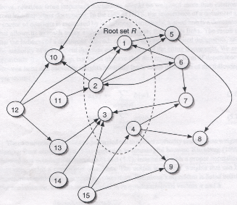
Random Walks on Graphs

Slide 2
What is a Random Walk
Given a graph and a starting point (node), we select a neighbor of it at random, and move to this neighbor;
Then we select a neighbor of this node and move to it, and so on;
The (random) sequence of nodes selected in this way is a random walk on the graph

Slide 3
An example
Adjacency matrix W
Transition matrix Q
B
1
1
1
1/2
1
1
A
1
C
1/2
Slide from Purnamitra Sarkar, Random Walks on Graphs: An Overview
3

Slide 4
An example
t=0, A
B
1
1/2
A
1
1/2
C
Slide from Purnamitra Sarkar, Random Walks on Graphs: An Overview
4

Slide 5
An example
t=0, A
t=1, AB
B
1
1
1/2
1/2
A
1
1
1/2
C
1/2
Slide from Purnamitra Sarkar, Random Walks on Graphs: An Overview
5

Slide 6
An example
t=0, A
t=1, AB
B
1
1
1/2
1/2
A
1
1
1/2
C
1/2
t=2, ABC
1
1/2
1
1/2
Slide from Purnamitra Sarkar, Random Walks on Graphs: An Overview
6

Slide 7
An example
t=0, A
t=1, AB
B
1
1
1/2
1/2
A
1
1
1/2
C
1/2
t=2, ABC
t=3, ABCA
ABCB
1
1/2
1
1
1/2
1
1/2
1/2
Slide from Purnamitra Sarkar, Random Walks on Graphs: An Overview
7

Slide 8
Random walks and Markov chains
A Markov chain describes a stochastic process over a set of states according to a transition probability matrix
Markov chains are memoryless
Random walks correspond to Markov chains:
The set of states is the set of nodes in the graph
The elements of the transition probability matrix are the probabilities to follow and edge from one node to another

Slide 9
Random Walk algorithm
Input:
- the adjacency matrix W of a graph G=<V,E>
A subset of nodes VC having property C
• Initialization of nodes:
if v∈V_{C} then p0(v) = 1 / |VC| else p₀(v)=0
• Set transition matrix: Q= D⁻¹W
where D is a diagonal matrix with
d_{ii} = Σ_{j} w_{ij}
• Iteratively update until convergence or until t=k
pt = Q^{T}pt-1
Output: pt

Slide 10
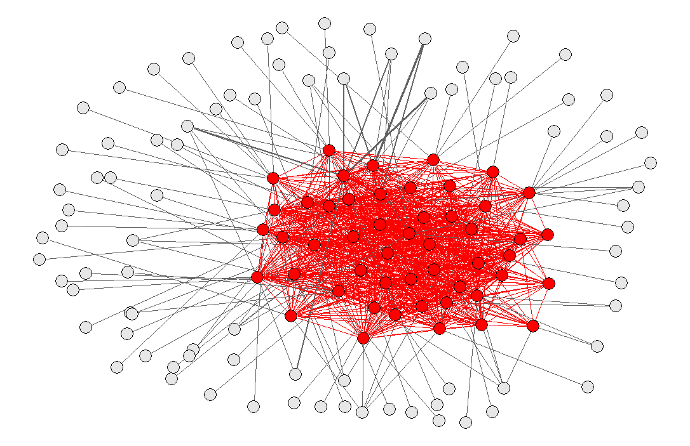
Random walking algorithm to rank genes
w.r.t to a given “property” C
A subset V_{C} of a set of genes V have “a priori” known property C
Can we rank the other genes in the set V \ V_{C} w.r.t their likelihood to belong to V_{C} ?
Random walk
algorithm
C can be e.g. a disease (gene disease prioritization) or a GO term (gene function prediction)

