Slide 1
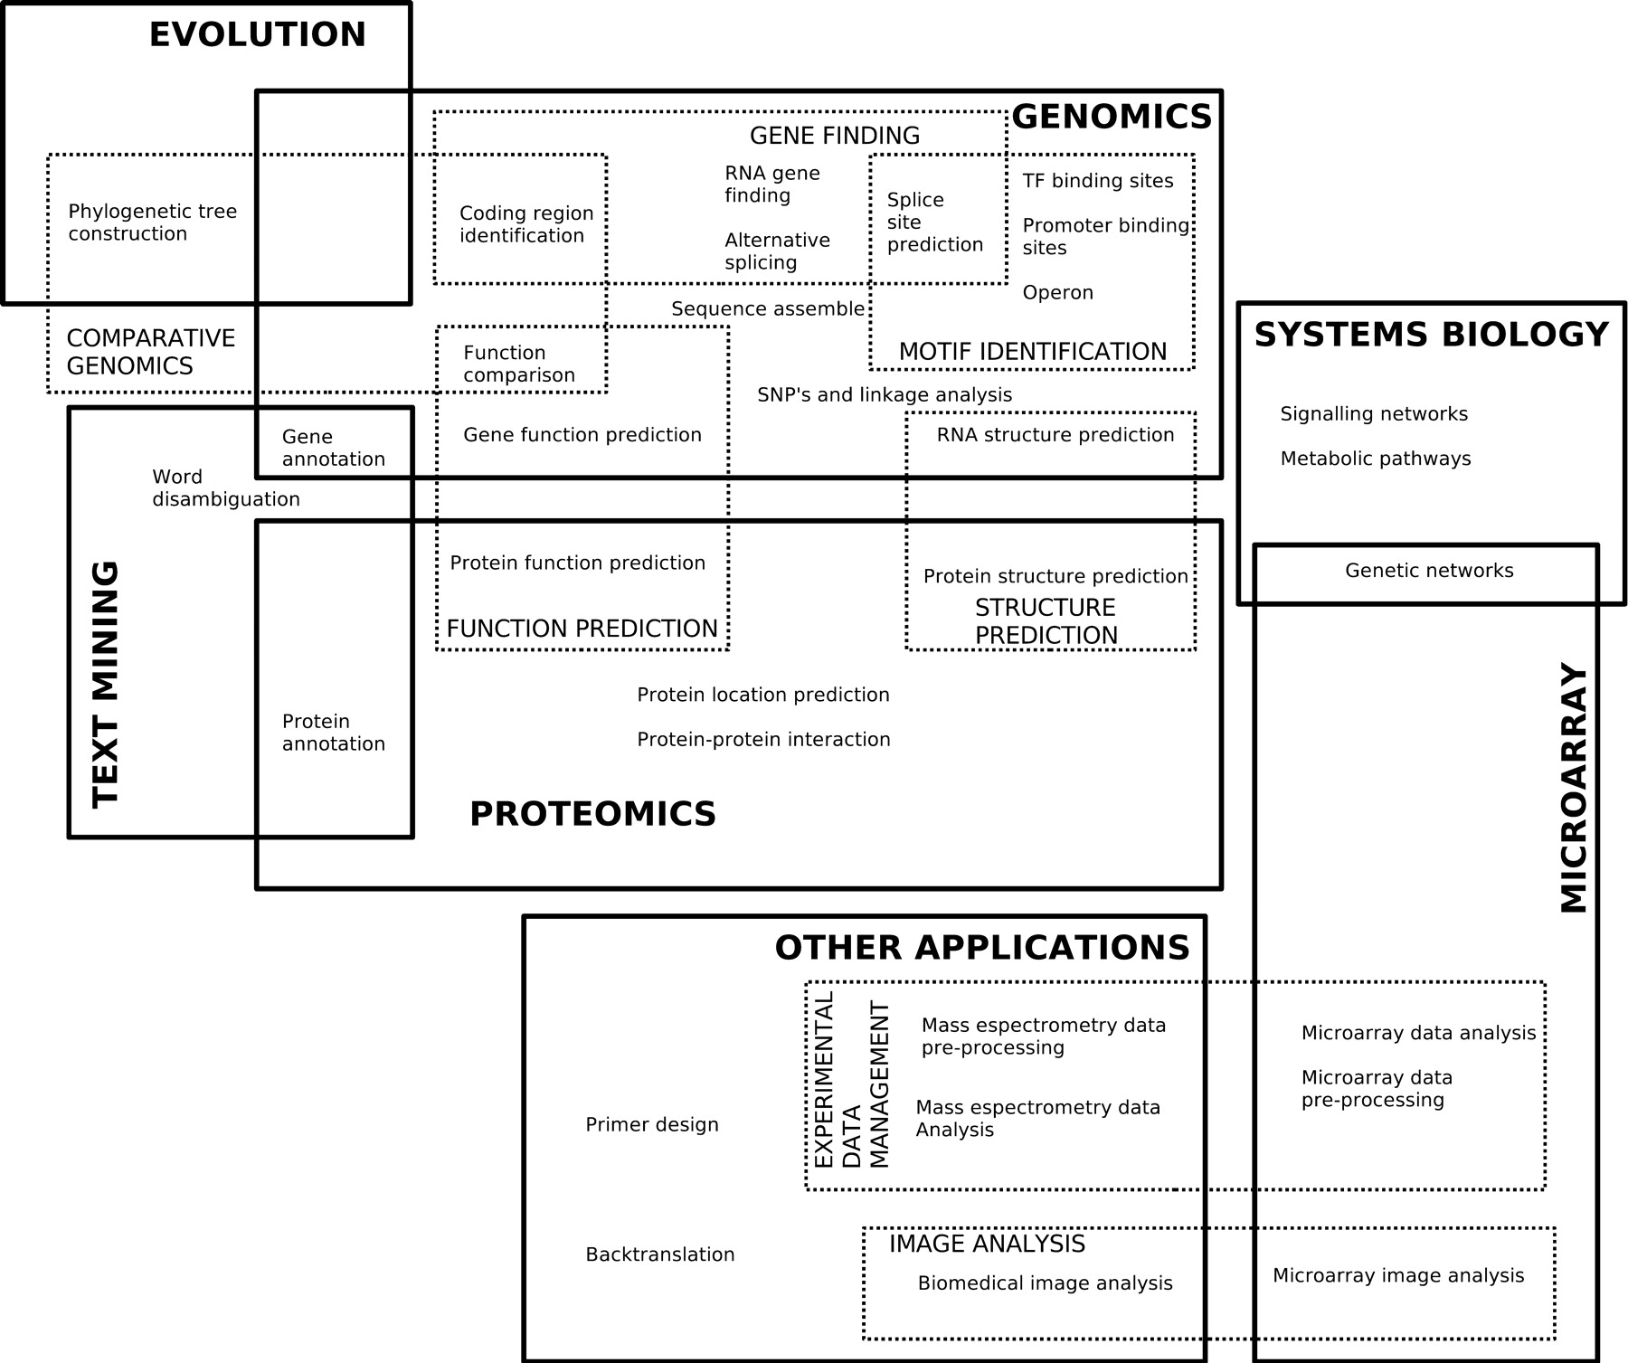
Classification of the topics where machine learning methods are applied.
Pedro Larrañaga et al. Brief Bioinform 2006;7:86-112
© The Author 2006. Published by Oxford University Press. For Permissions, please email: journals.permissions@oxfordjournals.org
Notes:
Classification of the topics where machine learning methods are applied.

