Slide 1
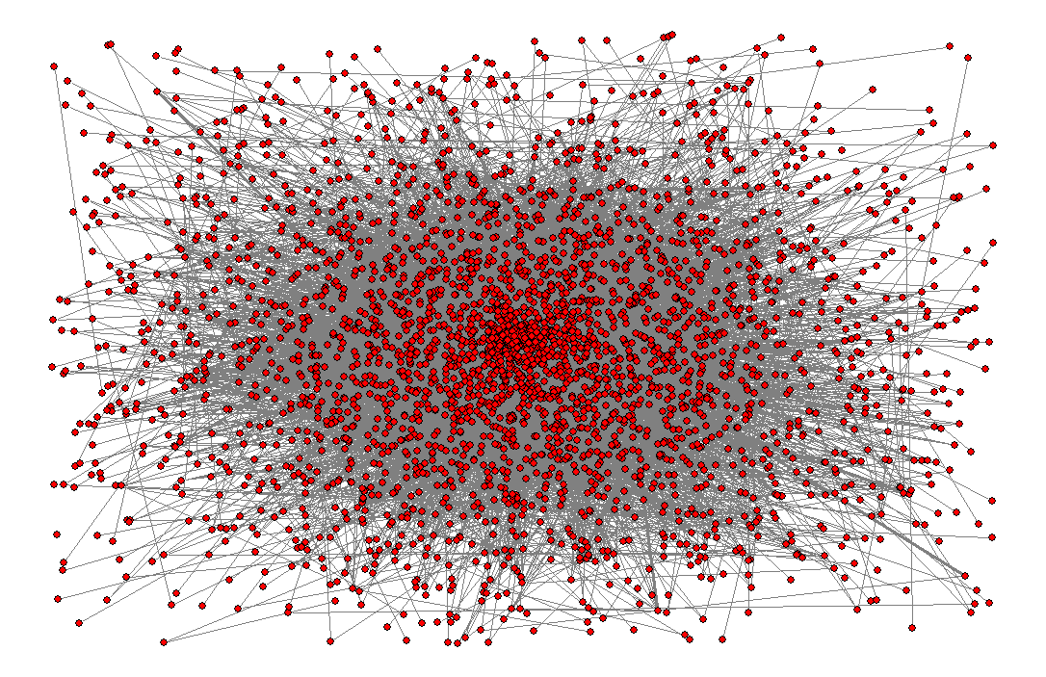
An introduction to biological network analysis

Slide 2
Biological networks
We cannot understand life by simply characterizing its ‘single components’, but considering the interactions and the relationships between its components: a systemic approach.
Biological networks are fundamental tools in the context of ‘system biology’
‘Omics’ data (genomic, trascriptomic proteomic, data) are used to construct biological networks and graph theory and machine learning methods are applied to model and analyze these complex objects.

Slide 3
Biomolecular data and processes can be naturally represented as networks
Some very general examples:
Protein-protein interactions
Enzyme/ligand interactions
Gene regulatory networks
Metabolic pathways
...

Slide 4
A link between two proteins if...
The proteins interact physically and form large complexes
The proteins are enzymes that catalyze two successive chemical reactions in a pathway
One of the proteins regulates the expression of the other
…

Slide 5
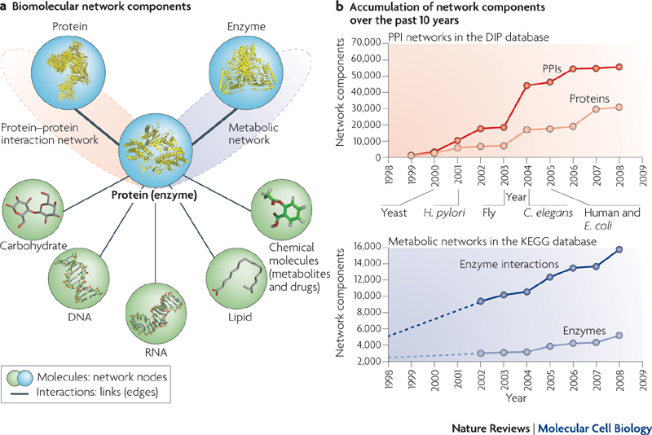

Slide 6
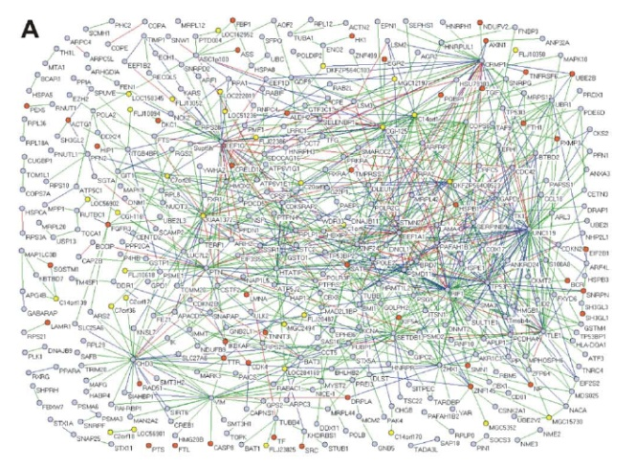
PPI Networks from Y2H Screens
Defined different levels of confidence
Identified disease genes
Assessed overlap with literature-based interactions
Used GO annotation
Ulrich Stelzl et al. A Human Protein-Protein Interaction Network: A Resource for Annotating the Proteome, Cell, vol.122, 2005
<number>
Notes:
<number>
Including mapping interactions in human cells and comparing the identified interactions from the yeast-2-hybrid method with previously identified interactions detected through low-throughput methods and reported in many publications also showed little overlap. However, this does not necessarily means that the yeast-2-hybrid method is the only one full of false-positives.

Slide 7
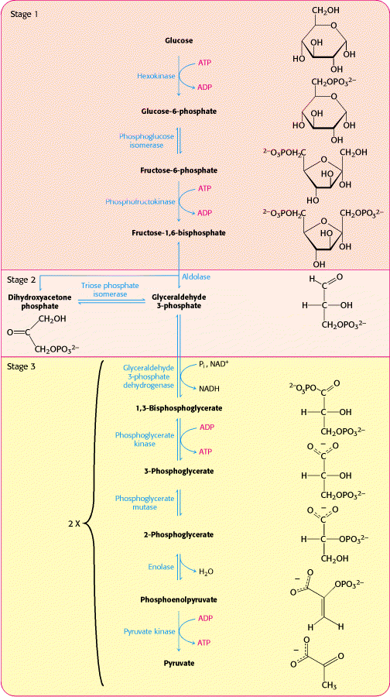
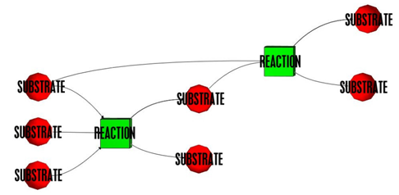
Metabolic Networks
Glycolysis
Bourqui et al. BMC Systems Biology 1:29 (2007)
Two types of nodes: enzymes and substrates
Reactions can be directional or bidirectional
Berg et al. Biochemistry
New York: W. H. Freeman and Co.; c2002
<number>
Notes:
<number>
Metabolic networks are commonly represented by two types of nodes: enzymes and substrates. Reactions can be directional or bidirectional. These networks are commonly represented as bipartite graphs where reactions are connected to substrates.

Slide 8
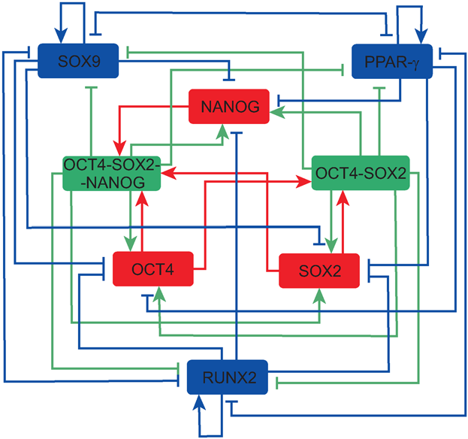
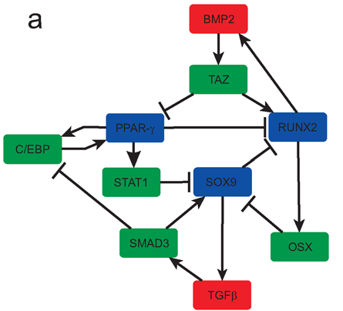
Example of Gene Regulation Networks
Stem cell differentiation regulation
Nodes are genes and transcription factors
Interactions can be directional or bidirectional
Interactions can be activation or inhibition
MacArthur et al., PLoS ONE 3: e3086 (2008)
<number>
Notes:
It is common to represent transcriptional regulatory networks with the nodes being a merge of genes and transcription factors while the links represent regulatory interactions that include the effect of the transcription factors on the expression and activity of other factors. MacArthur et al showed, in this study, that both embryonic stem-cells and osteoblasts are regulated by circuits made of nested positive feedback loops, while components from each circuit inhibit components from the other positive feedback circuit. Using dynamical simulations MacArthur et al showed how cells typically go from the undifferentiated state to the differentiated state smoothly. However, if noise is added to the two connected circuits, differentiated cells can “jump” back to the embryonic state, suggesting a role for noise in iPS reprogramming.
<number>

Slide 10
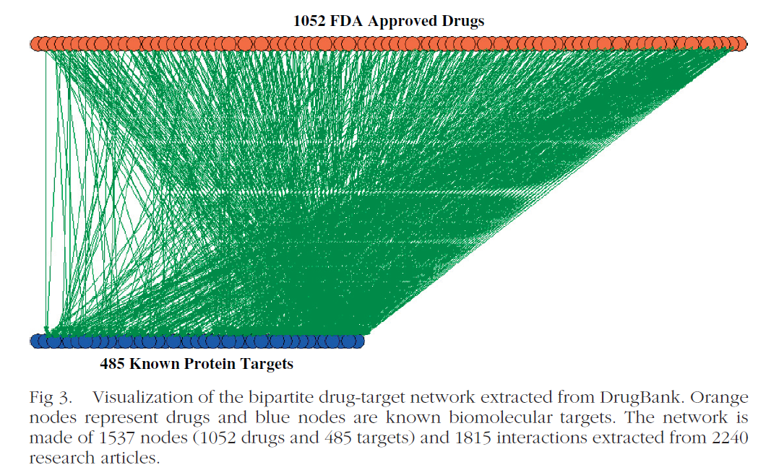
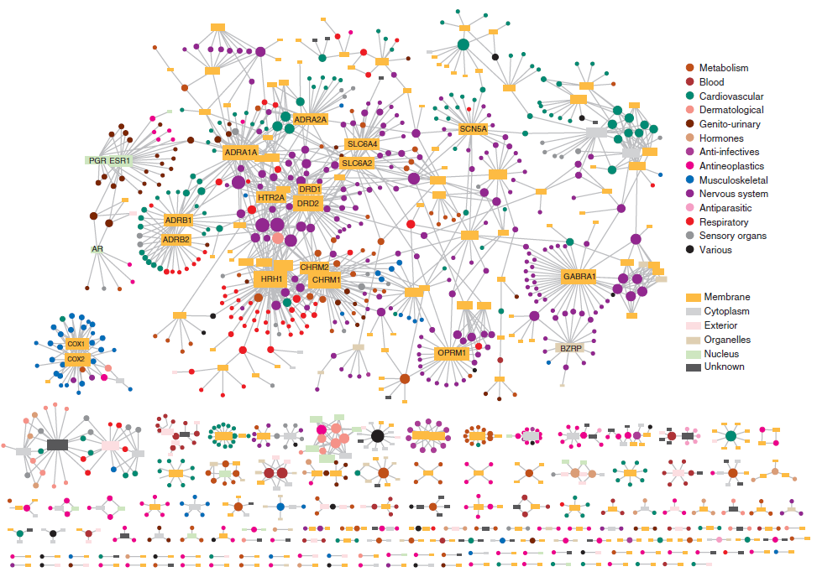
Drug-Target Networks
Drugs can be connected to their known protein targets
Ma’ayan et al. Mt Sinai J Med (2007) 74:27
Yildirim et al. Nat Biotechnol. (2007) 25:1110
<number>
Notes:
All networks discussed so far connect endogenous molecular components with each other. Here is an example of networks that connect drugs to their molecular targets. These networks are bipartite graphs containing two types of nodes: FDA approved drugs and their direct drug-target proteins.
<number>

Slide 11
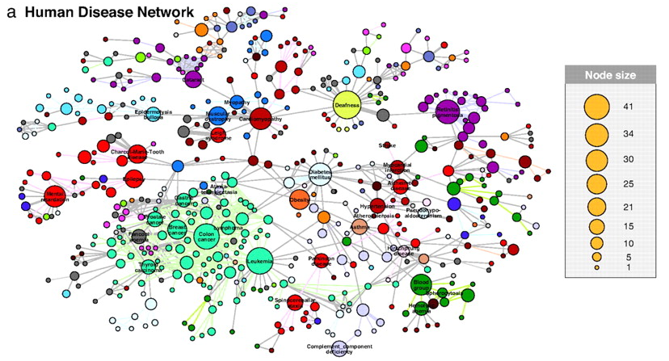
Disease Gene Networks
Goh et al. Proc Natl Acad Sci USA. (2007) 104:8685-90
Each node corresponds to a distinct disorder, colored based on the disorder class. The size of each node is proportional to the number of genes in the corresponding disorder, and the link thickness is proportional to the number of genes shared by the disorders connected by the link.
<number>
Notes:
<number>
Nodes in biological networks can be connected through and with more abstract types of nodes, for example, nodes that represent diseases. Here each node corresponds to a distinct disorder, colored based on the disorder class. The size of each node is proportional to the number of genes indentified as containing mutations that can cause the corresponding disorder, and the link thickness is proportional to the number of genes shared by two disorders.
<number>

Slide 12
Networks are inter-linked
Signalling pathway
STIMULUS
Genetic
network
Metabolic pathway

Slide 13
Interactions → Networks → Pathways
A collection of interactions defines a network
Pathways are subsets of networks
All pathways are networks of interactions, however not all networks are pathways!
Difference in the level of annotation or understanding
We can define a pathway as a biological network that relates to a known physiological process or complete function

Slide 14
Sources for interaction data
Literature: research labs have been conducting small-scale experiments for many years!
Interaction dabases:
MIPS (Munich Information center for Protein Sequences)
BIND (Biomolecular Network Interaction Database)
GRID (General Repository for Interaction Datasets)
DIP (Database of Interacting Proteins)
...
High- throughput experiments:
Y2H (yeast two-hybrid method)
APMS (affinity purification coupled with mass spectrometry)
...

Slide 15
Integration of multiple sources of data to construct interaction networks
Use other data sources to create an integrated protein network.
Other sources include:
Genome data:
Existence of genes in multiple organisms
Locations of the genes
Bio-image data
Gene Ontology annotations
Microarray experiments
Sub-cellular localization data

Slide 16
Protein interaction networks
Large scale (genome wide networks):
ProNet (Asthana et al.)
Yeast
3,112 nodes
12,594 edges

Slide 17
Analyzing Protein Networks
Predict members of a partially known protein complex/pathway.
Infer individual genes’ functions on the basis of linked neighbors.
Find strongly connected components, clusters to reveal unknown complexes.
Find the best interaction path between a source and a target gene.

Slide 18
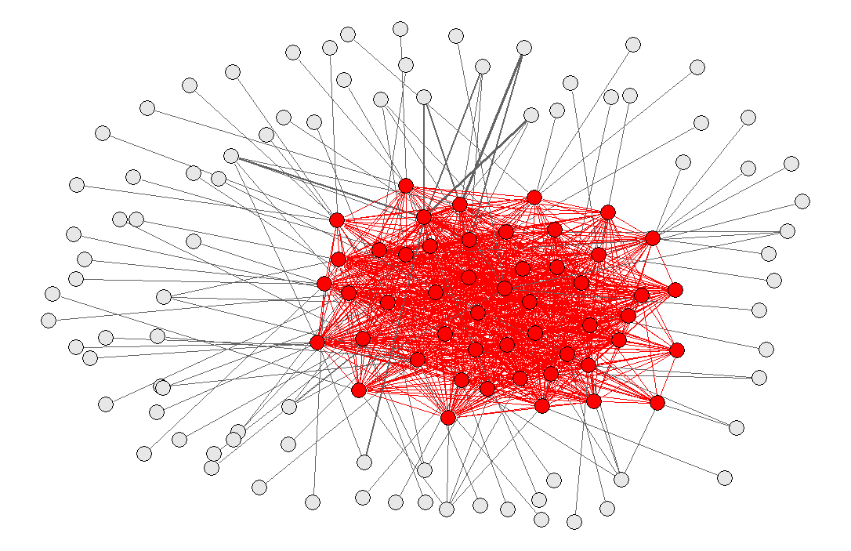
Gene Function Prediction (GFP)
Having a set V of genes, a subset VC of genes are “a priori” known to belong to a given functional class C (i.e. a Gene Ontology class)
Can we predict whether other genes in the set V \ VC may belong to C?

Slide 19
Disease gene prioritization
Having a set V of genes, a subset VC of genes are “a priori” known to be associated to a given disease C
Can we rank genes in the set V \ VC with respect to their likelihood of being associated to C?

